Slide 1
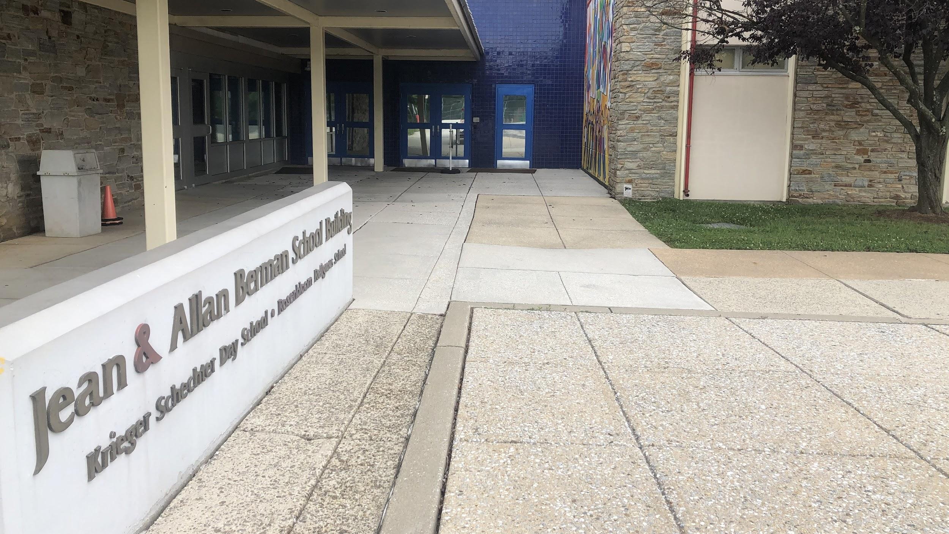
Krieger Schechter Day School:
Roadmap to Reopening
As of July 24, 2020

Slide 2
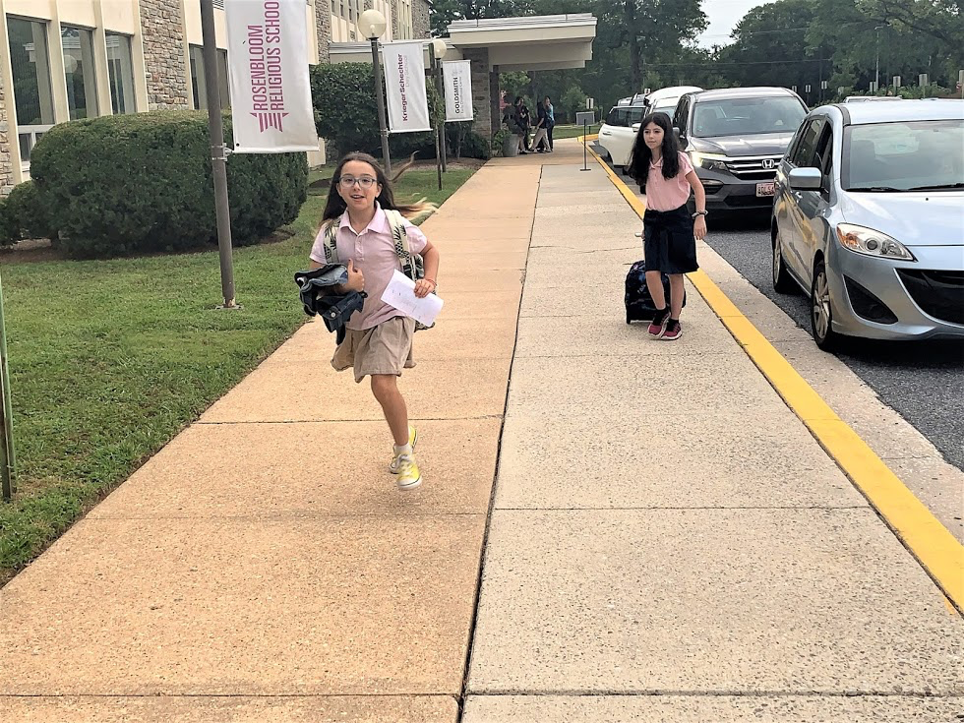
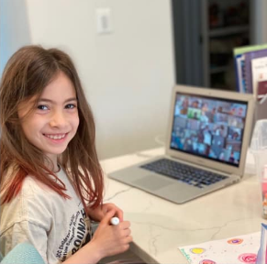
Table of Contents
Our Approach to Reopening
Model A: On-Campus With Restrictions
Building Advancements
Model B: Fully At-Home
Model C: Hybrid At-Home and On-Campus with Restrictions
Still To Come
Communications Cadence
Key Upcoming Dates
Advisory Committees

Slide 3
Our Approach to Reopening
Krieger Schechter Day School’s philosophy and priorities remain the same as always, even in this challenging world of 2020.
Our decisions are made through thoughtful, deliberative, impassioned discourse with all stakeholders, based on the values of our mission statement and our love for our community.
We prioritize the health and safety of our students, teachers, families and staff.
We prioritize our students’ academic learning.
We prioritize our faculty’s capability to teach with creativity and best practices in pedagogy.
We prioritize the social, emotional, and spiritual well-being of our students, teachers and families.
In a novel situation characterized by uncertainty and risk, we have the courage to make challenging decisions guided by a steadfast commitment to our mission.
We recognize the complexity of education during a global pandemic, and have created a flexible approach to Fall 2020 that demonstrates our resilience and adaptability as a school.

Slide 4
Flexible Approach to the 2020-2021 School Year
It is our obligation as a school to be fully prepared for a variety of predictable scenarios for the 2020-2021 school year. These include any school model along this continuum:
Our plans recognize that this school year requires educators and families to be prepared for any and all of these scenarios to occur, at any time, for various durations. There are advantages and disadvantages to all models, and those considerations are different for every member of our community.
None of this is easy. None of this has definitive clarity. There is no single “correct” solution for all members of our community. We are all in this process together, and as partners in your child’s education, we are poised for success. Our community, committing together to accomplish shared goals, is what makes us who we are at KSDS.
Hybrid of at-home/on-campus Fully on-campus with restrictions
Fully virtual/at-home Fully on-campus with few/no
restrictions

Slide 5
Wellness and Mental Health
We recognize that unprecedented stress, isolation and anxiety caused by the COVID-19 pandemic continues to impact our students and their families in ways that are continually unfolding.
Mental health and well-being will continue to be carefully considered as we construct new schedules and as we devise policies related to lunch, recess, homework, physical distancing, mask-wearing, etc. We understand the need for social interaction and frequent check-ins with teachers and counselors. We will continue to draw on school and community resources as needed to support the mental health of our entire school community.
Using our Social Emotional Curriculum, Bo N’daber, as our foundation, we will teach and reinforce positive behaviors and healthy decision making and provide a safe, supportive, and healthy school environment. Using our themes such as a safe and caring community, citizenship, respect, perseverance, along with other core values, we will continue to support and nurture all of our students.
We continue to explore creative ways to adapt our programming, from Friend-to-Friend to Tefillah (prayer/spiritual experiences) and Bo N’daber, to provide additional emotional support and connection during this time.

Slide 6
Daily Schedule
School Class Hours (whether on-campus or at-home):
Mondays-Thursdays 8:15am-3:30pm (LS)
Mondays-Thursdays 8:15am-3:45pm (MS)
Fridays 8:15am-2:45pm (please note: consistent K-8 Friday schedule all year)
When we are at home:
LS and MS Zoom classes will take place at consistent, designated times throughout each day; plenty of screen breaks and movement experiences will be provided to ensure a balanced, whole-child approach to at-home learning.
When we are on campus:
Morning drop-off will begin at 7:50am each day; whenever students arrive, they will proceed directly to their classroom for the beginning of the day. No students are permitted out of their cars until 7:50am. Students must arrive at school by 8:10am.
At dismissal time, carpools that include Lower School and Middle School students should arrive at school for Middle School dismissal time; Lower School siblings will wait in classrooms for their Middle School carpool. New arrival and dismissal procedures, including new drop-off and pick-up locations, will be shared the week of August 17th.
After-School Care:
We are working on arrangements for Playkeepers to take place each day. Playkeepers will meet from 3:45pm until 5:30pm Monday through Thursday and Fridays until 5:00. Details coming soon. A revised payment policy will also be announced.

Slide 7
Kvutzah /קְבוּצָה
קְבוּצָה is the Hebrew word for group. This school year, each student will be placed in an academic cohort - or קְבוּצָה - that will be a subset of your child’s grade. The average group size of each קְבוּצָה will be 14 students.
Kvutzah size will be determined by the size of the learning space, ensuring that each space has a minimum of 6 feet of social distancing availability. We are grateful to Chizuk Amuno Congregation for ensuring KSDS has access to larger function areas enabling us to maintain cohorts.
Students will remain in their kvutzah for most of the day. In some grades, there will be minimized mixing of cohorts for leveled classes. For on-campus learning, in order to facilitate easy and safe transitions during the school day and to minimize passing in the hallways, LS students will keep jackets with them in the classroom, and MS students will keep backpacks and jackets with them as well.
In the coming weeks, we will be further defining what kvutzah means, and how teachers can provide differentiated instruction within a kvutzah.

Slide 8
Model A:
On-Campus With Restrictions

Slide 9
Campus Reopening: Safety Levels
We created a three-tiered safety level system to align our reopening plans with CDC guidelines, public health conditions, and other independent AIMS schools in the area. When the campus opens, it will open at a Red Safety Level. As we hopefully move into the orange and yellow safety levels later this year, we will communicate all changes in a timely fashion in order to provide you and your families with ample time to prepare.
Red
Orange
Yellow
Strictest Level
Mandatory at-home daily health screening
6-ft social distancing indoors and outdoors
Masks required indoors
Frequent hand washing
Only faculty, staff and students permitted in the building
Designated entrances and exits
No hot lunch service
Water fountains disabled; bottle-filling stations available
Any person traveling from a high risk COVID 19 state or county is required to self-quarantine and cannot come to school until a 14-day incubation period has been observed. See here for the full policy.
Elevators limited to 1 person at a time
Playground closed
No field trips
No singing activities on campus
Stricter Level
Mandatory at-home daily health screening
Masks required indoors
Frequent hand washing
Visitors permitted in building with scheduled appointments
Designated entrances and exits
No hot lunch service
Water fountains disabled
Elevators limited to 1 person at a time
No field trips
Strict Level
Mandatory at-home daily health screening
Masks required indoors
Frequent hand washing
Visitors permitted in building
Designated entrances and exits
Resume partial hot lunch service
Water fountains disabled
*These safety levels may be amended depending on new and updated information.

Slide 10
Role Of Families
Families play a vital role in maintaining safety for our community. It is imperative that families understand and follow all of our health and safety policies and procedures. The opportunity to return to campus is reserved for those students and families who understand their obligation to the community and follow the policies. Non-compliance could result both in compromising the health and safety of our community and in the closure of the building for all.
The most important safety measures for parents to follow in addition to social distancing and mask-wearing are: 1) to keep children home if they are sick in any way, and 2) to limit families’ exposure to non-household members, including specifically maintaining 6ft of social distancing outside of school as much as possible. We will work with families to support their child’s adherence to safety measures while they are on campus; it is parents’ responsibility to support their family’s adherence outside of school.
We understand that there are families with higher-risk members in their households. As a community that prioritizes health and safety, we must do our part to adhere to state health recommendations and regulations to control transmission and potential future outbreaks. Moreover, there may be times when we ask families to comply with additional safety measures and we greatly appreciate your cooperation in this regard.
We also expect you will have questions and welcome your feedback and suggestions. We will host Town Hall meetings for parents in the coming weeks in order to communicate our reopening plans.

Slide 11
Travel Restrictions
Any person who travels for business or pleasure to a high risk COVID 19 state or county is at increased risk of getting sick with COVID 19. Any person traveling from a high risk COVID 19 state or county is required to self-quarantine and cannot come to school until a 14-day incubation period has been observed.
If a student travels outside of Maryland via air or public transit, the student is also required to self-quarantine and cannot come to school until a 14-day incubation period has been observed.
Parents are reminded that their own business travel puts the parent -- and then the family to whom they return -- at temporarily increased risk for a 14-day incubation period. We ask that enhanced protection be practiced at home during this time including: more frequent hand washing, maintaining 6 feet of distance, wearing masks indoors and increased wiping down of high touch surfaces. Should any symptom of potential COVID 19 illness arise during those 14 days, exposed KSDS community members (students or staff) must stay home until the sick individual is determined not to have COVID 19 by a medical professional.
Non-compliance could result both in compromising the health and safety of our community and in the closure of the building for all.

Slide 12
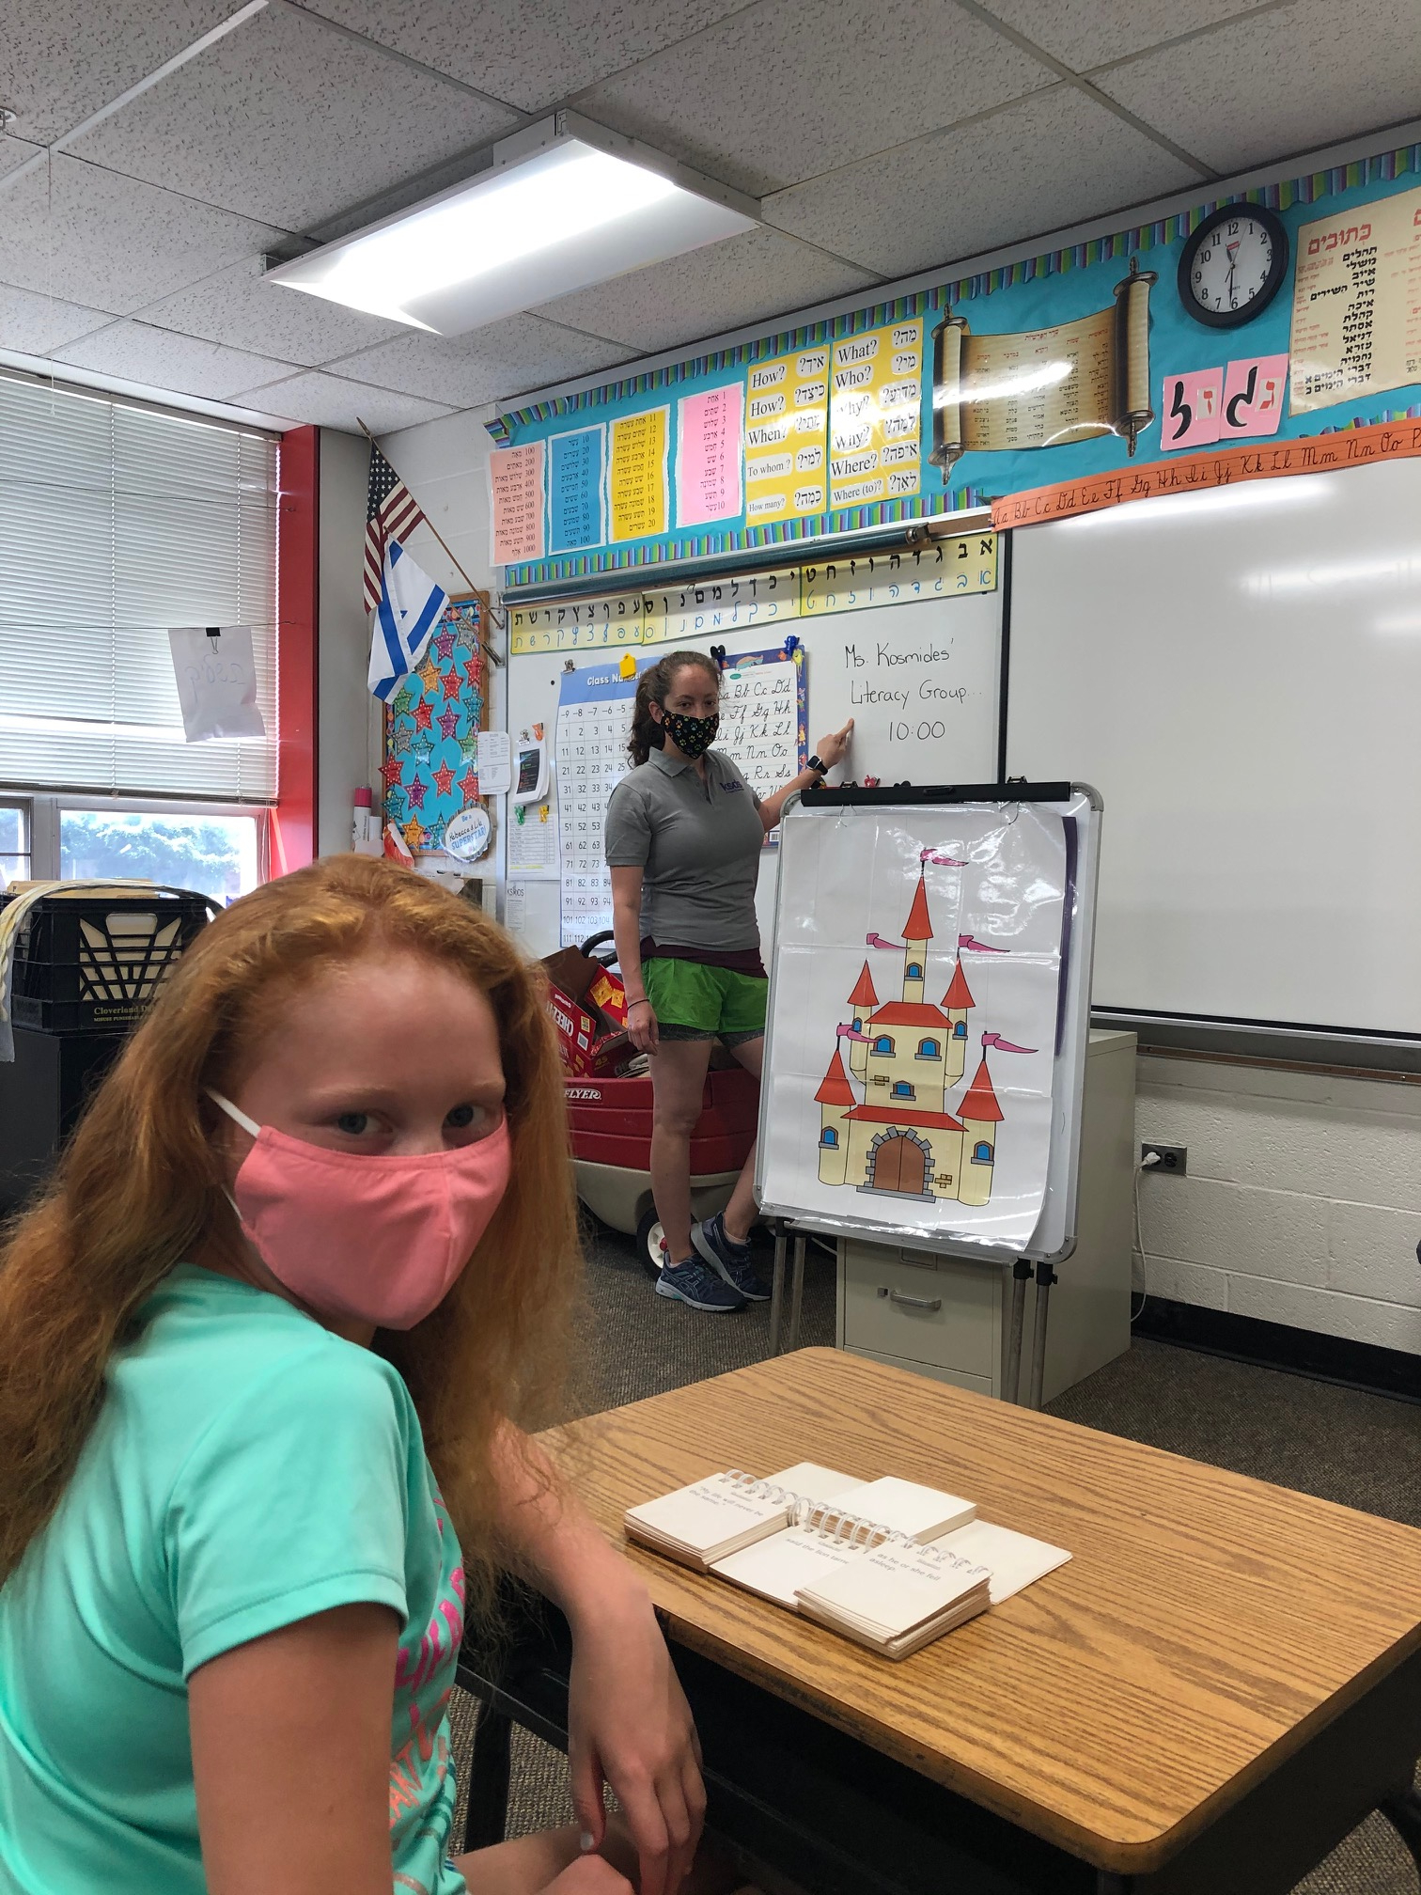
On-Campus with Restrictions Model
LS and MS are finalizing schedules and working with teachers to create pedagogical best practices for a socially-distanced learning environment that:
recognizes how different on-campus learning will look and feel than in previous years
is based on the summer’s K-8 reflective look at curriculum and pedagogy in General and Judaic Studies, focusing on the essential questions and big ideas that frame student learning goals
employs a daily schedule that optimizes consistency from day to day
includes ample time for breaks between classes, with the goal of going outside during breaks whenever possible
explores outdoor opportunities for learning, eating and recess / P.E.
utilizes the synagogue’s and schools’ larger spaces to allow for social distancing in every class
allows students to keep their supplies and coats with them to maximize learning and break times
includes systems for students to act throughout the school day with safety as a priority, growing their independence in that process
includes systems for organization of student supplies
creates opportunities for socially-distanced interaction, physical activity, artistic expression and Jewish living experiences.
includes multiple opportunities for well-being and mental health check-ins
allows individual students who are learning at-home (or temporarily at-home for illness/isolation) to follow the same schedule as students on-campus
Sample LS schedule here (subject to change). Sample MS schedule here (subject to change)

Slide 13
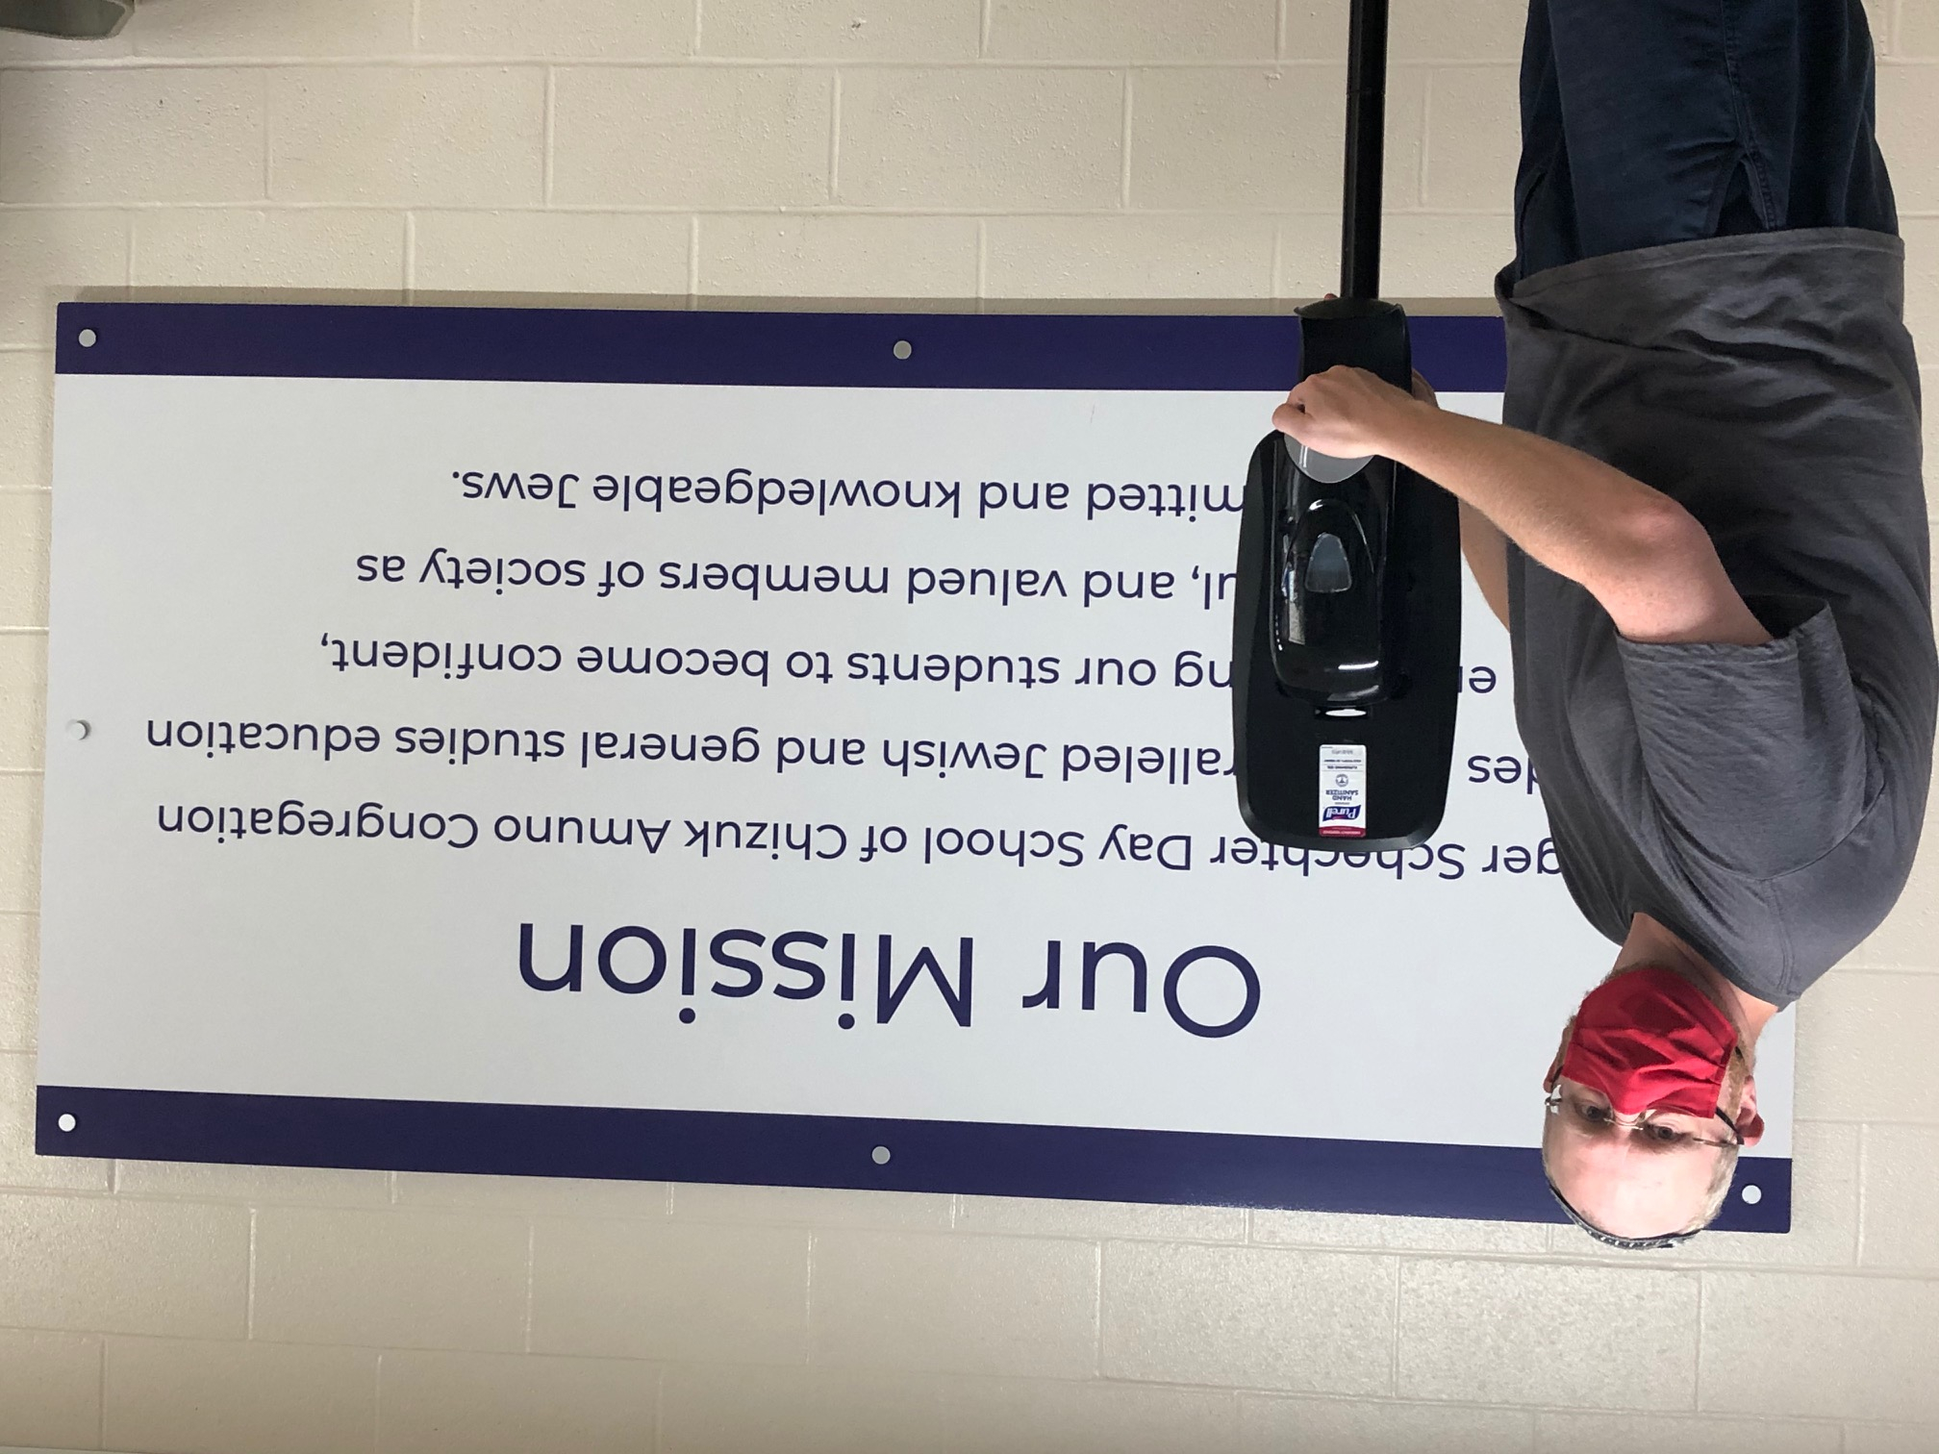
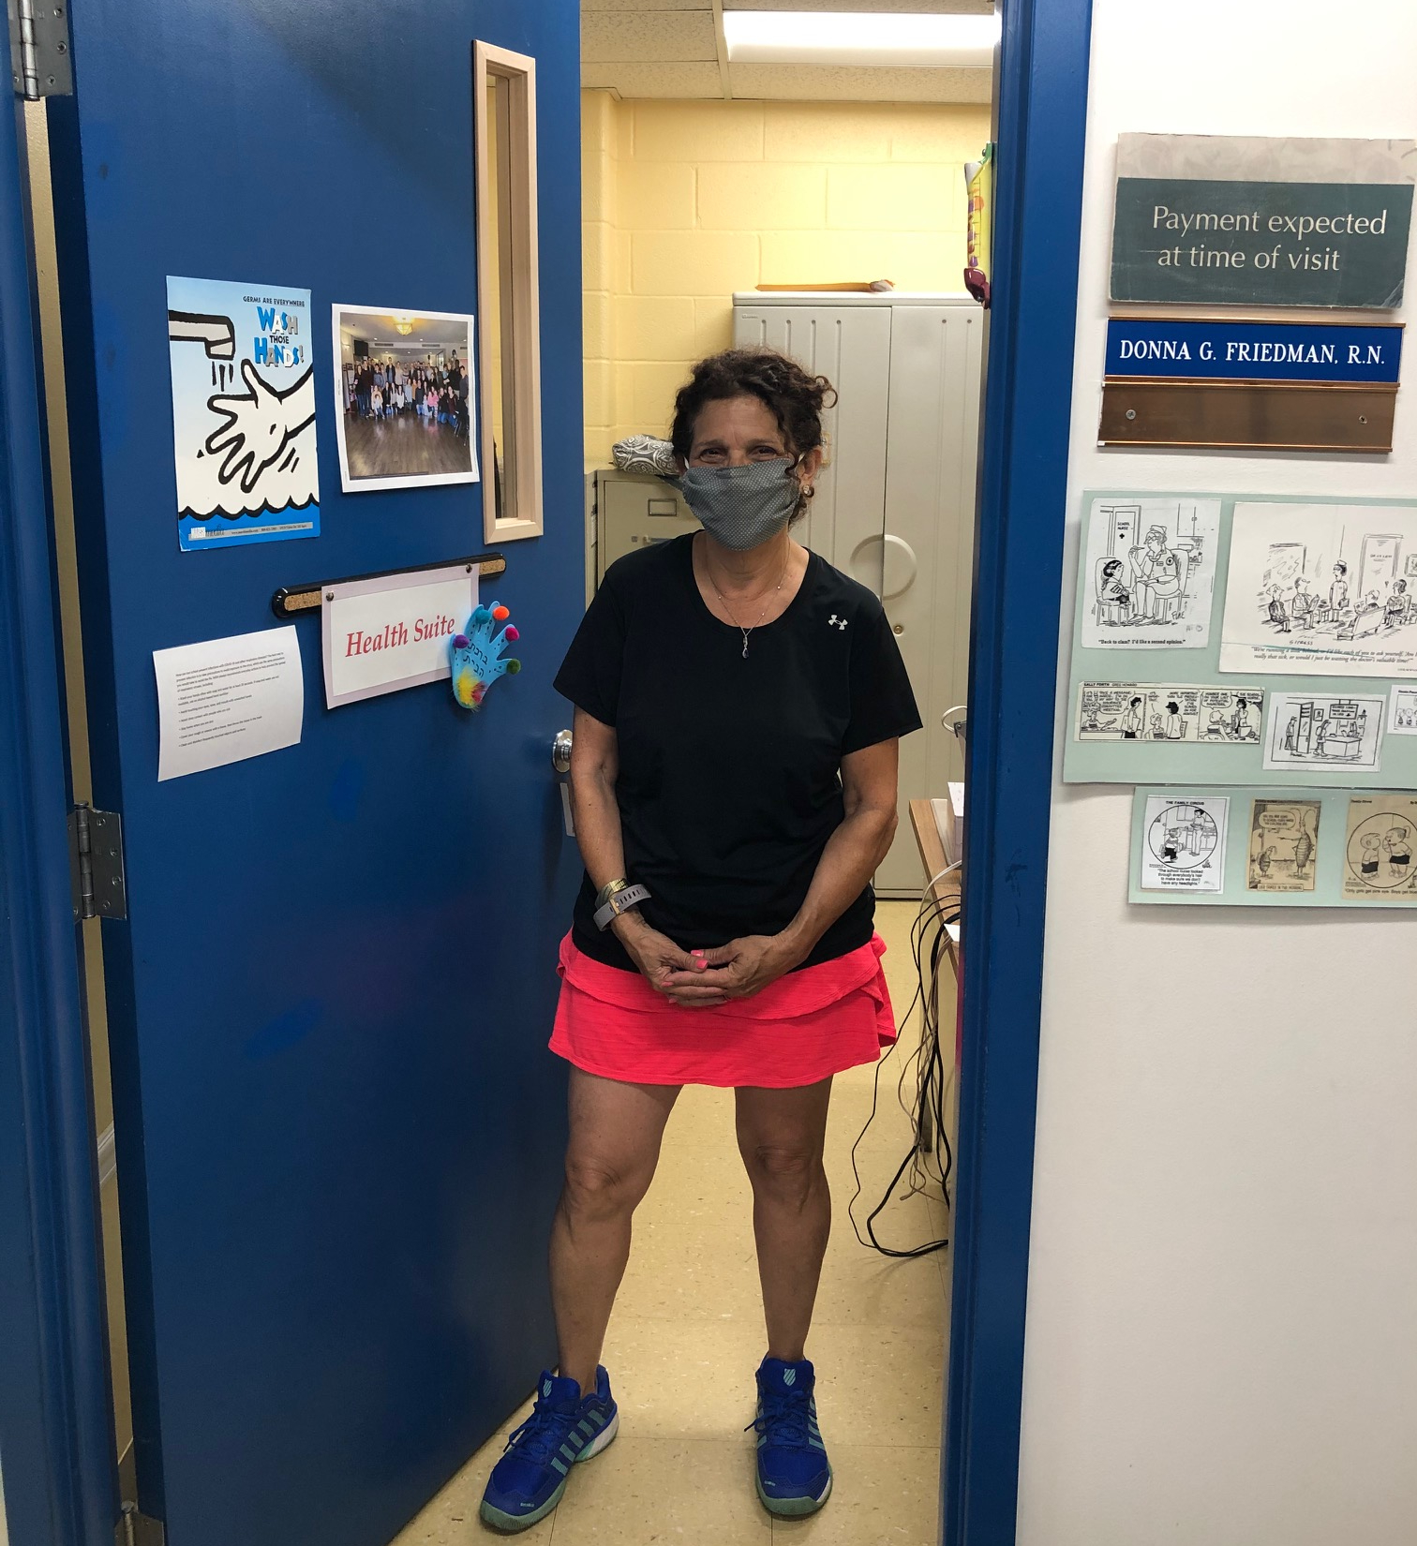
Health & Safety Policies for Campus Reopening
Daily Health Screenings
Mask Policy
Personal & Classroom Hygiene Practices
Cleaning Practices
Managing Contact with COVID 19 at Home
Student/Staff Illness That Arises at School
Communicating Levels of Illness
Building Visitor Policy
Gym Class, P.E., Recess & Middle School Sports
Dress Code Changes for 2020-2021
Additional Resources

Slide 14
If KSDS Opens On-Campus, Likely a Phased-In Return to Campus
In order to help our students, faculty and families acclimate to the many new procedures and as-yet-unfamiliar routines of on-campus learning this year, IF we open at the beginning of the year on-campus, we ask parents to expect a gradual phased-in opening for different grade-levels.
A phased-in on-campus opening could include the following, over the course of the first three weeks of school:
Half-days for Kindergarten on 8/31 and 9/1.
Two additional grades beginning on-campus on the first day of school and additional grades being added in the subsequent days and weeks until all grades have been phased-in for on-campus learning.
Grade-levels that are not yet phased-in for on-campus learning will have a full class schedule every school day via our at-home learning model, until they are phased in. The specific schedule for phased-in opening on campus will be shared in mid-August.
Our phased-in opening allows for acclimation for all stakeholders, and allows fuller staff attention to each group of students as it comes new to on-campus learning, for the teaching and practicing of new protocols.

Slide 15
Choice to Learn At-Home When Campus is Open
Krieger Schechter is committed to providing an at-home KSDS learning program for any students whose families choose for them to remain at home even if the KSDS campus is open for learning. We recognize that the choice to accept even minimized risk of being on campus is not the right choice for every family. We also recognize that the choice to stay learning at home is not the right choice for every family.
On July 28th, parents will receive an email link to a survey to indicate choice of on-campus learning or at-home learning for each of their KSDS children.
Students choosing to learn at home will follow the same daily class schedule as students on campus.
Decisions about the exact structure and instructional delivery method for students at home will depend on the numbers of at-home students in a particular grade.
Students learning at home might have a livestream/Zoom connection to their on-campus assigned class, or students learning at home might be in a dedicated “at-home” Zoom section of their own.
Students learning from home will have various methods of communication with their teachers, and will have various options for demonstrating participation in class.
KSDS is working creatively and thoughtfully to plan for community connection and sense of belonging for those students choosing to learn at home.
NOTE: Students who normally are on-campus learners, but are temporarily home because of illness or requirement to isolate/quarantine are welcome to watch a livestream of their on-campus class, whenever available. If a livestream is not available for a particular class period, students who are temporarily at home will be given time with a teacher to work on the material covered during class.

Slide 16
Building Advancements
The entire building is undergoing a thorough, deep cleaning including increased sanitization. Additionally, we are implementing the following changes in order to further enhance the safety of our students, faculty and staff:
All HVAC systems will be adjusted to optimize the flow of outside air
All filters will be replaced with MERV-13, the best commercial unit available and changed on a more frequent basis
System coils will be sprayed with disinfectant on a weekly basis
To the extent possible, windows in all classrooms will remain open to circulate air
A plexiglass divider has been added to the security guard station at the main entrance and will be added to other locations throughout the building
Hand sanitizer stations are being installed in common areas and offices as well as each classroom
Some staircases and hallways will be designated as one-way with appropriate signage
New signage throughout the building will indicate hygiene policies and social distancing protocols
Some classrooms were expanded to enlarge the classroom footprint

Slide 17
Model B:
Fully At-Home

Slide 18
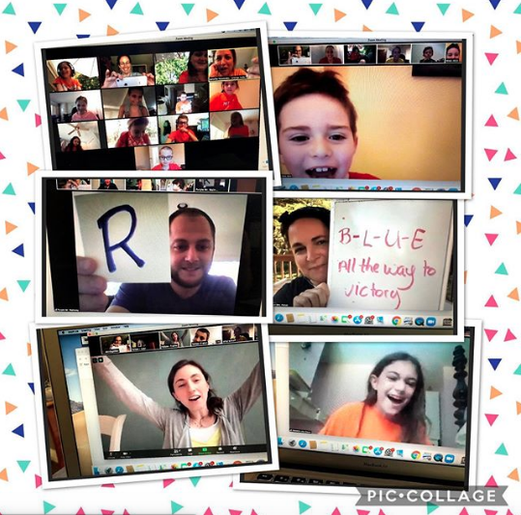
Fully At-Home Model
Our teachers are using this summer, through ongoing professional development, to build on the at-home learning from this past spring, learning from our successes and adapting for even greater learning enhancement.
LS and MS divisions are finalizing schedules and planning pedagogy for at-home learning that:
is robust with varied learning experiences in all subjects
is based on the summer’s K-8 reflective look at curriculum and pedagogy in General and Judaic Studies, focusing on the essential questions and big ideas that frame student learning goals
occupies student time each day in a way that balances screen/zoom time, individual creative and work activities, and down-time
utilizes an ever-growing array of tools and techniques for interactivity and student engagement
creates opportunities for social interaction, physical activity, artistic expression and Jewish living experiences.
reflects upon methods of assessment and grading for at-home learning, to both evaluate student progress and maintain student motivation/accountability
utilizes additional approaches to support students who have challenges learning from home

Slide 19
Model C:
Hybrid At-Home and On-Campus with Restrictions

Slide 20
Hybrid Model
As our students and teachers acclimate to the new physical and emotional demands of 2020-2021 teaching and learning, we may choose to implement a hybrid model, combining opportunities from both at-home and on-campus experiences.
Hybrid possibilities could include:
The whole school learning on-campus some days and at-home on other days each week
Each grade-level having some assigned days on-campus and some assigned days at home
Additional models to be determined based on current conditions
A hybrid model provides us with opportunities to orient and support students and staff with regard to the safety/health procedures in place. Depending on the hybrid structure, it may also allow administration and health/wellness services to support a smaller number of students on campus at any one time. Some hybrid models also allow the lessening of in-person exposure in a week.

Slide 21
Benefits for Students in Different Models
Benefits of on-campus learning:
Opportunities for in-person peer interactions
Opportunities for in-person relationship-building with teachers
Sense of physical belonging to a broader school community
Change of scenery for students - learning and experiences out of their homes
Benefits of at-home learning:
The ability to work in more intimate learning groups via Zoom
Seeing classmates’ unmasked faces directly
Utilizing facial expressions as part of the learning process, including visual cues of the mouth as part of language learning
The ability for teachers to work individually with students, seeing their work “up-close” and responding privately to individual students’ needs
By definition, a hybrid model provides the benefits of both scenarios, on different days

Slide 22
Still To Come:
As we work to build the best policies for on-campus learning, we are currently working on drafting updated procedures for the following topics:
Lunch and snack time
Birthdays, Bnei Mitzvah and other in-school celebrations
Library books
Individual student meetings with counselors, admin and teachers in larger, yet private, settings
Updated Parent and Student Handbook
Arrival and dismissal procedures
After-school enrichment and other special programming
Special orientation plans for our transition grade-levels (K and 5th) and plans for milestone events for 8th graders (8th Grade Play, Israel Trip, High School transition process and more)
We will share policies on these items as soon as they’re fleshed out. In the meantime, let us know if there are further topics you’d like us to address.

Slide 23
Communications Cadence
We will continue to send regular communication updates throughout the summer, including opportunities for parents to come together on Zoom to ask questions. Here is our planned schedule for reopening-related communications:
Week of July 27 KSDS Parent (K-8) Town Hall Meeting Monday 7/27 via Zoom at 8pm
Parent survey distributed on Tuesday 7/28
Week of August 10 Lower School and Middle School division emails
(School supply lists, curriculum, schedule, academic and school activities plans)
Week of August 17 Back to School procedures communicated (arrivals & dismissals, lunch, etc.)
August 17 KSDS Middle School Parent Town Hall Meeting via Zoom at 8pm
August 19 KSDS Lower School Parent Town Hall Meeting via Zoom at 8pm
Week of August 24 LS class lists and MS student schedules released via Renweb

Slide 24
Key Upcoming Dates
August 2 KSDS launch of a new “school store” for online purchases of SchechterWear
August 20 First tech training* session for parents (optional) via Zoom at 8pm
August 24 Second tech training* session for parents (optional) via Zoom at 8pm
*Tech trainings are optional, but will give parents a better understanding of how to navigate our communications and teaching platforms including Google Classroom, Zoom, Renweb, and more.

Slide 25
Advisory Committees
To help guide our thinking with regard to the fall, we created Advisory Committees to focus on all planning aspects surrounding two core focuses: health & safety, and finance.
The committees are comprised of KSDS administration, board and faculty, current and alumni parents, medical professionals, as well as Goldsmith Early Childhood Center and Chizuk Amuno Congregation staff, to allow for the most effective collaboration and support between the congregation and schools.
As part of the committees’ work, we will be issuing a parent survey in late July to aid our reopening plans and further gauge comfort levels in regard to returning to the building.
In addition to the internal committees, we are following CDC guidelines and remain in ongoing communication with other independent AIMS schools to share ideas on reopening plans.

Slide 26
This pandemic is a complex challenge, but we will continue to look for the best solutions to meet the needs of our community. This reopening plan is preliminary, and it will continue to evolve until the first day of school.
In the meantime, feel free to reach out with any questions or concerns.
Rabbi Moshe Schwartz, Head of School, mschwartz@ksds.edu
Dr. Robyn Blum, Middle School Head, rblum@ksds.edu
Mrs. Wendy Gelber, Lower School Head, wgelber@ksds.edu

