Slide 1
Hybrid Learning 101
Please note this is a working document.
Permission to reuse so long as you reference this slide deck.
Kathleen Reardon
Director of Academic Technology, Dedham Country Day School
Twitter: @magistrareardon
Site & Contact Info: KathleenReardonConsulting.com

Slide 2
Guiding Questions
What does hybrid learning mean at our school?
How might we approach our curriculum differently in order for students to achieve learning goals successfully?
What methods, tools, and mindsets will we need to leverage to help our students be successful?
KathleenReardonConsulting.com

Slide 3
What is Hybrid Learning?
Blended learning is the integration of tech into the classroom so that the students are learning from both teacher-directed and self-directed methods throughout the curriculum.
Hybrid learning has been used interchangeably with blended learning, but often with a sense of more online time than in-person time and, as in the age of COVID-19, much of the online time happens in a different physical location.
Some resources put these terms on a spectrum from
teacher-controlled learning experience to student-controlled learning experience.
KathleenReardonConsulting.com

Slide 4
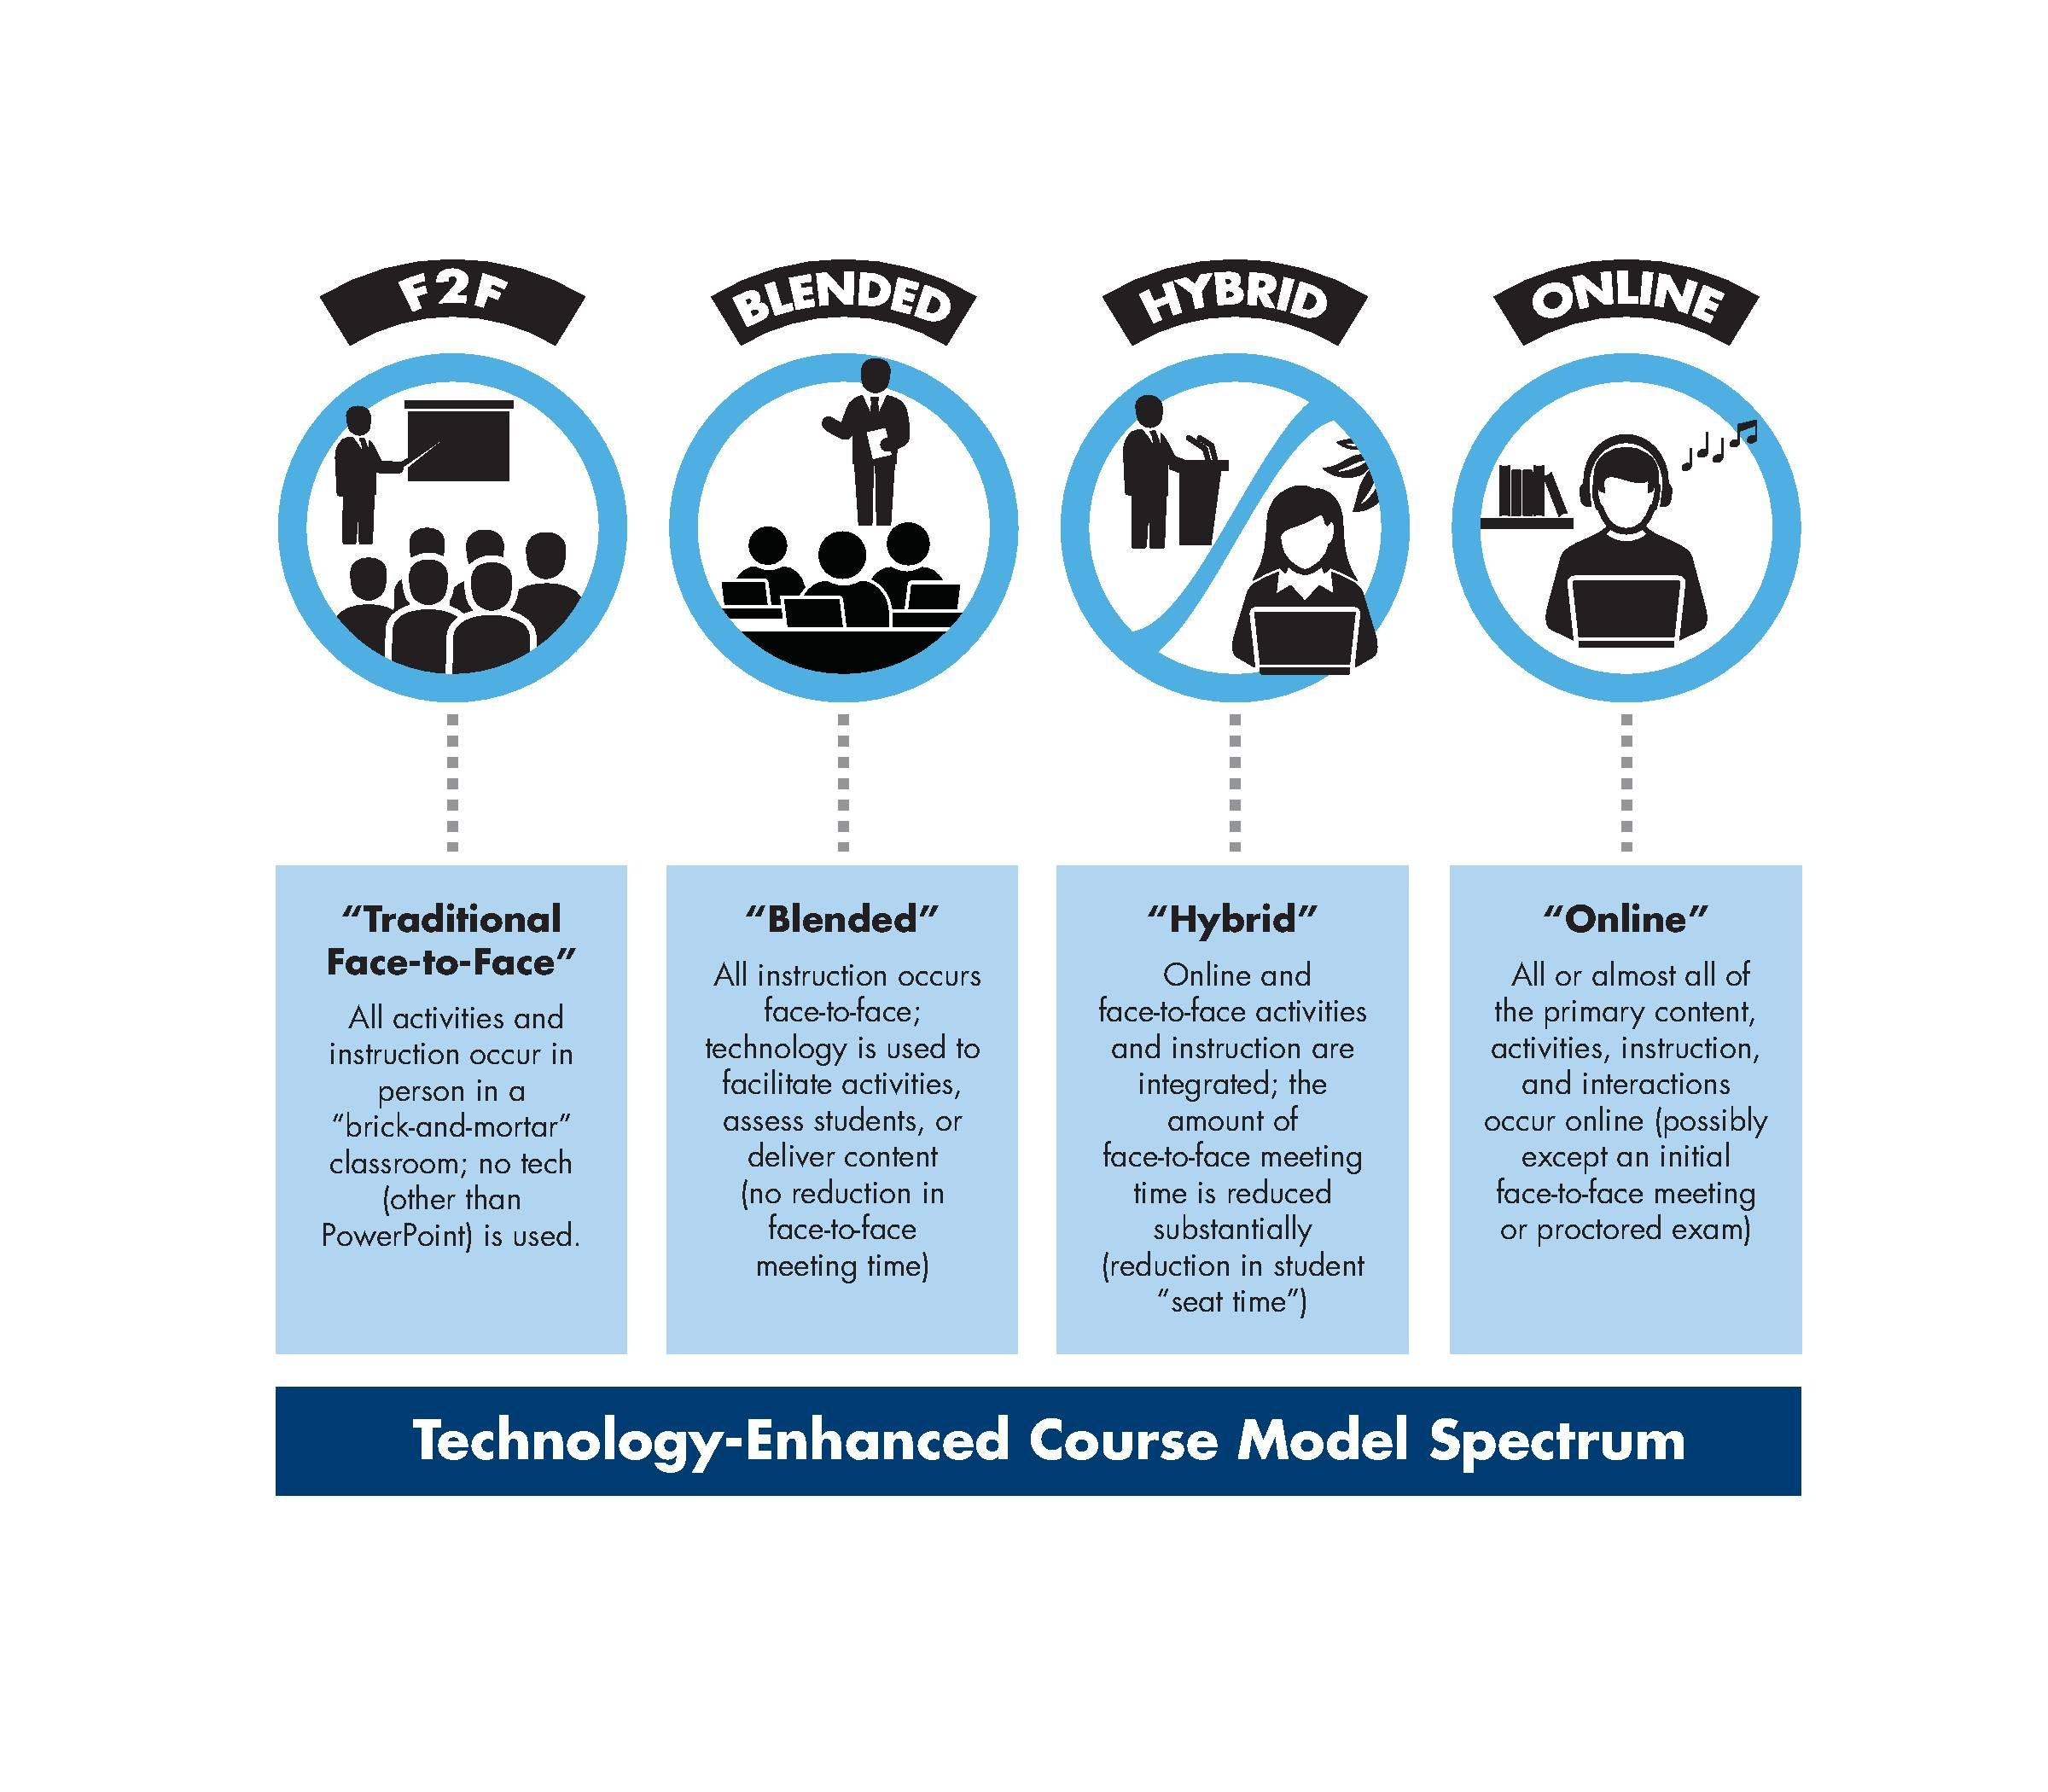
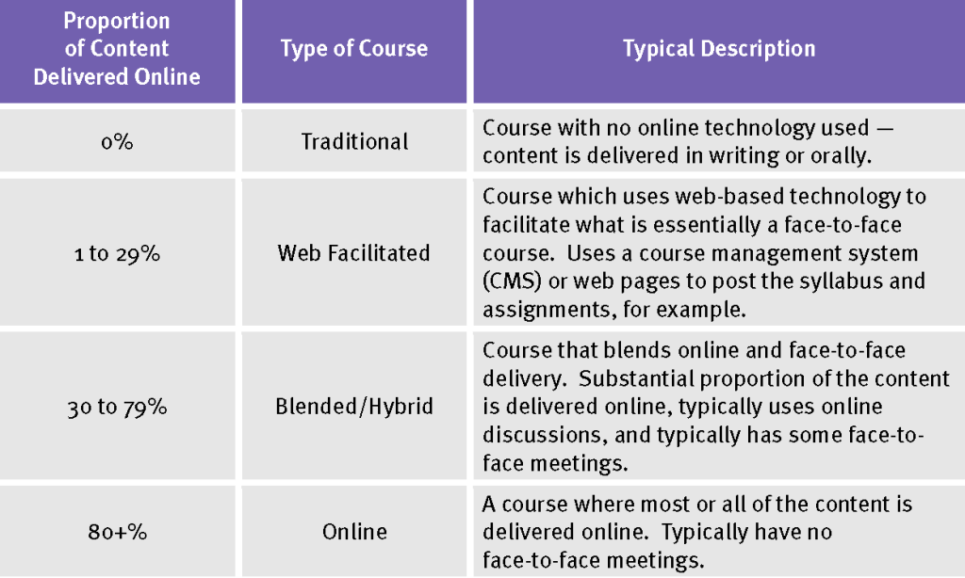
KathleenReardonConsulting.com

Slide 5
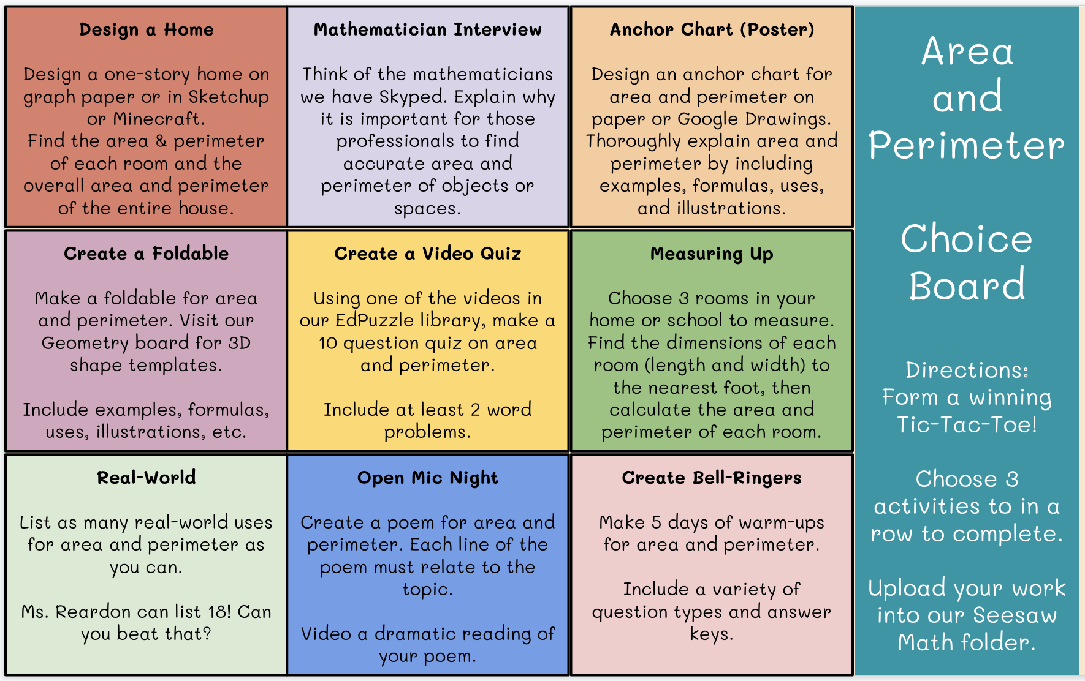
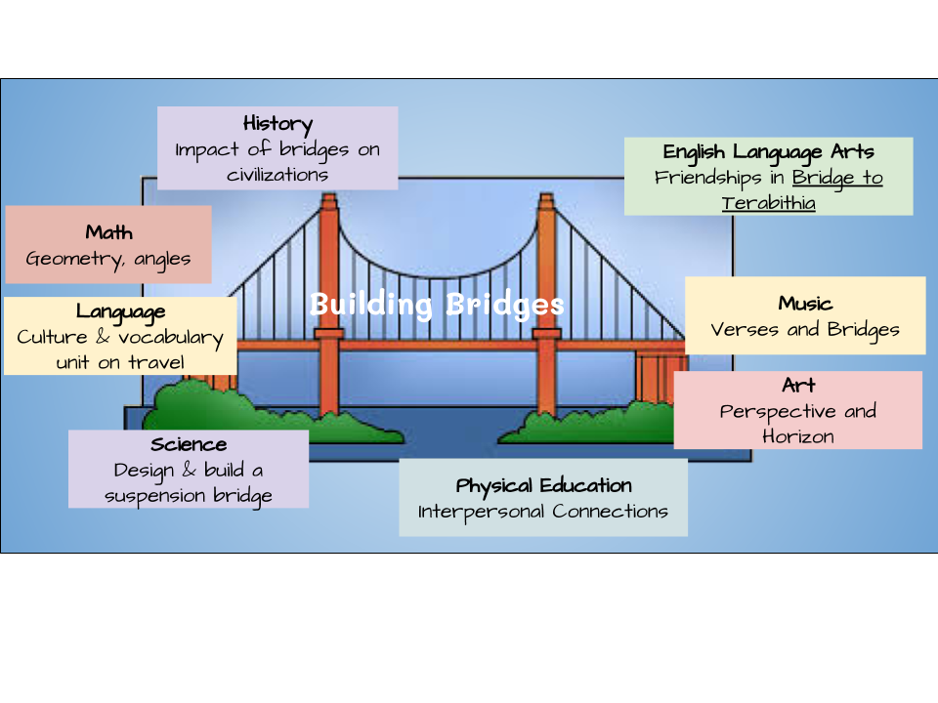
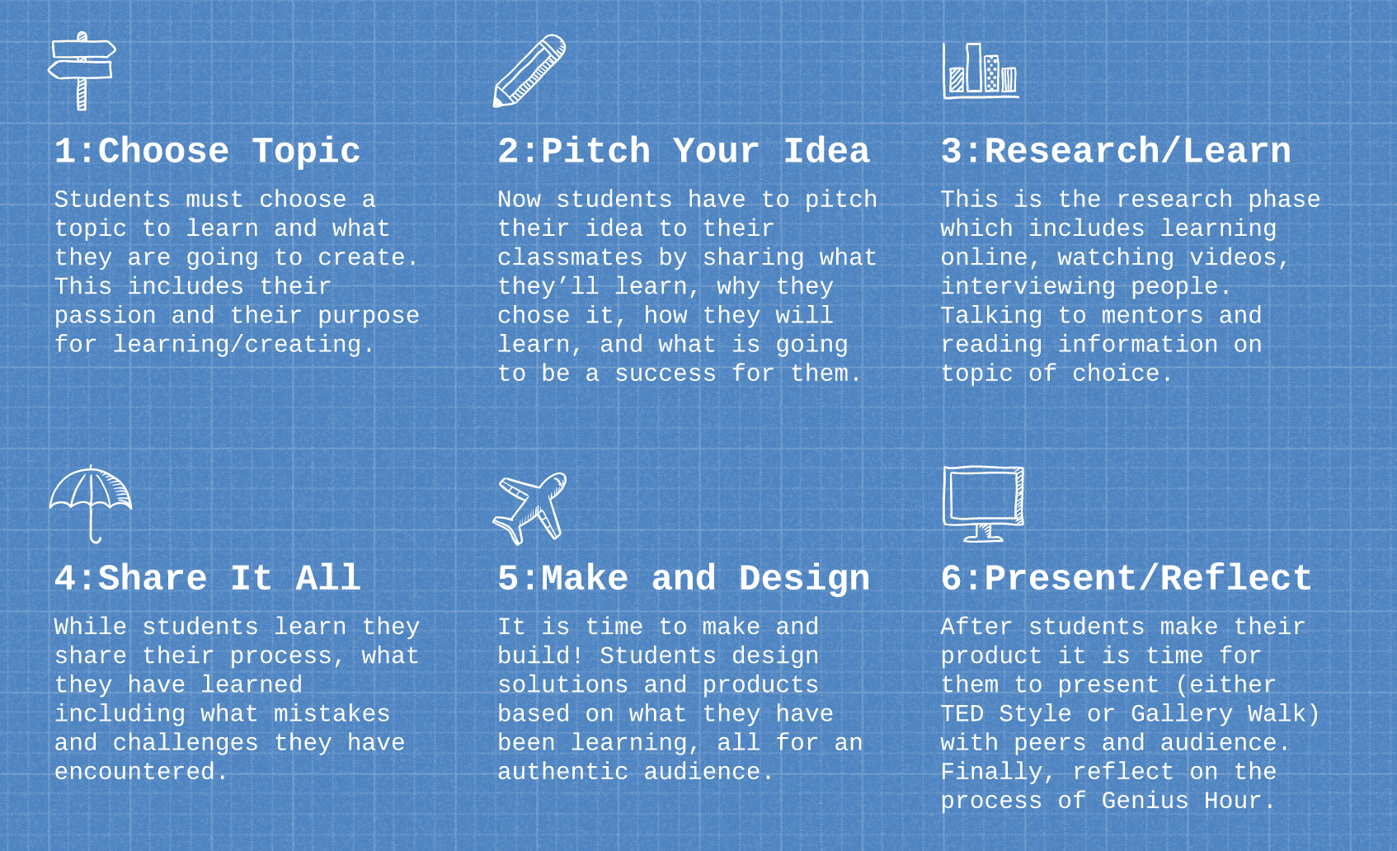
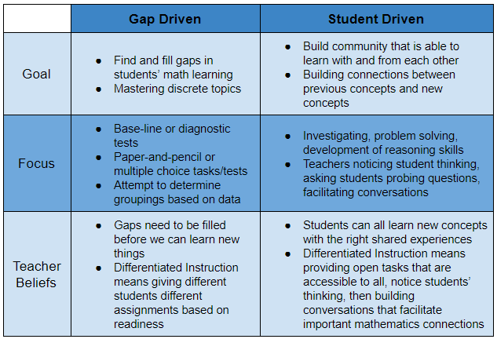
Teaching Models for Hybrid Learning Success
Choice Boards
Station Rotation
Thematic & Cross-Curricular
Recommended for strengthening teacher/student relationships.
Differentiate by including “must-do” and “level up” options at each station.
Likely to be leveraged in more classrooms this fall to more efficiently and effectively assess student gaps and understanding.
Flipped Classroom
Independent Projects
Competency-Based Assessment & Differentiation
Allows students to self-pace.
Frees up teachers to work with students individually and differentiate.
“Anytime I’m tempted to stand up and talk at my students, I make a video.” ~ Catlin Tucker, blended learning expert
KathleenReardonConsulting.com

Slide 6
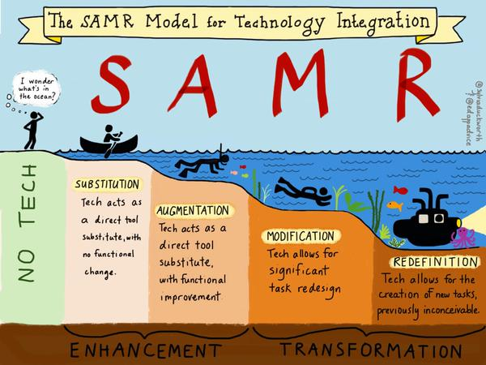
Emergency Closure
Online Learning vs. Hybrid Learning
Successes
Quick turnaround in making programming available online
Leverage new tech tools to facilitate connection and content delivery
Schools that employed “all hands on deck” approach saw greater success than pared-down approach
Challenges
High rate of substitution, low rate of redefinition due to time constraints
Tech solutions are “hacked” to serve undesigned purposes, especially heavy use of PDFs for unintended purposes
Numerous & often poorly timed updates of tech
Opportunities
Teachers & administration have time to plan & build out resources & infrastructure
New tech tools & features come the market specifically designed to meet hybrid learning needs
Learning experiences are redesigned to be nimble and flexible in delivery
Challenges
Reduction in seat time must be balanced by team-teaching or cross-curricular approach
Reliability of technology and infrastructure is of key importance
Schools that strategically include families in planning process see greater success
Recommended reading:
The Difference Between Emergency Remote Teaching and Online Learning
KathleenReardonConsulting.com

Slide 7
What could hybrid learning look like in the age of COVID-19?
Reopen only for low-risk families and/or essential workers (Canada, NZ, Hong Kong, CDC)
Stagger reopening by grade level (China, Denmark)
Group A attends M/T, disinfect W, Group B attends Th/F (CDC, Hong Kong, Canada, NZ)
Reopen, followed by school closure for surge (Japan, South Korea, CDC)
Students in one class are spread out across classrooms or online (Hong Kong, CDC)
Smaller class sizes meet with less frequency (China, Canada, CDC)
Teachers rotate classrooms, students remain in one assigned desk (China, Denmark)
Neither students nor teachers rotate classrooms, specialists are Zoomed in (Hong Kong, CDC)
Electives & collaborative activities are online or re-designed for no-contact (Denmark, Germany, CDC)
Modular classrooms created, often without same resources / technology (Denmark)
Classes are/aren’t live streamed, project supplies are sent home for asynchronous assignments (Hong Kong)
Library and other shared materials are disinfected or quarantined after each use (Denmark, Hong Kong, CDC)
Reopening
Strategies
KathleenReardonConsulting.com
Hybrid
Designs
Infrastructure & Supplies

Slide 8

Summer 2020 PD Program
Guiding Questions
What does hybrid learning mean at our school?
How might we approach our curriculum differently for students to achieve learning goals successfully?
What methods, tools, and mindsets will we need to leverage to help our children be successful in a hybrid learning environment?
Timeline
Week of June 8 - Launch discussions around hybrid learning
Week of June 15 - Commit to your personal summer PD plan,
which will include approx. 3-4 hours each of learning, connecting, and planning
June 15 - July 1 - BREATHE
July 1 - August 24 - Complete your PD plan, approx. 1 hour per week
Week of August 31 - Share something you will do differently this fall
KathleenReardonConsulting.com

Slide 9
Reading, Podcasts, Articles, Webinars (Choose 3-4 hours)
Books & Sites
𝥷 Catlin Tucker's Blended Learning offers best practices in blended learning: chapters 3-5 (teacher's role in blended learning), chapter 10 (flipped classroom tips), and chapter 11 (assessment in blended learning).
𝥷 Joe Feldman’s Grading for Equity (prologue and chapter 1 are available here for free) discusses a vision for equitable grading in traditional, online, and blended learning environments.
𝥷 BlendedLearning.org and TeachThought’s 12 Types of Blended Learning offer a comprehensive collection of resources for leveraging the seven models of blended learning, such as rotations, flipped classrooms, choice boards, and cross-curricular learning.
Articles & Podcasts
𝥷 Brene Brown's podcast episode about FFTs provides a humorous and thoughtful framework for reflecting on what teachers have accomplished this spring and our mindset as we look towards what the fall might bring.
𝥷 John Spencer’s 6 Independent Projects for the First Week of School and Four Ways to Craft Choice Menus in Distance Learning Classes provide examples and templates for redesigning the learning experience.
𝥷 How Not to Start Class in Fall 2020 discusses how we could consider beginning the year with student-driven differentiation and formative data collection, rather than diagnostic learning gap assessment.
Online Courses (Approval Required)
𝥷 Integrating How We Teach Online with the Science of How We Learn from Learning & the Brain adds a layer of neuroscience and cognitive development to our understanding of online learning.
𝥷 Global Online Academy offers four different weeklong courses that address specific aspects of designing and assessing online learning. Each course requires approx. 4 hours asynchronously.
Visit our PD Calendar for additional resources
KathleenReardonConsulting.com

Slide 10
Facilitated In-House Conversations & Connections (Choose 3 - 4 hours)
𝥷 What Could Your Hybrid Learning Curriculum Look Like? A Facilitated Small-Group Brainstorm Session
𝥷 Cross-Curricular Design Methods: Independent Projects, Station Rotations, & Choice Boards
𝥷 Distance Learning Tools 2.0: Jamboard, Kami, Google Meet, NearPod, PearDeck, CoSpaces, and more!
𝥷 The Hybrid Mindset: What Our Community Needs to Be Well in a Hybrid Learning Environment
Additional Collaborative Possibilities
𝥷 Meetings with your Professional Development Cohort
𝥷 Cross-curricular planning with grade level teams
𝥷 “Unconference” around a topic of shared interest, led by you!
𝥷 How do we get to know one another online?
𝥷 Turning current events into actionable teaching moments
𝥷 Rethinking assessment in a hybrid learning environment
𝥷 1:1 or small group with Dir. of Academic Tech, Dir. of Learning, or School Psychologist
KathleenReardonConsulting.com

Slide 11
Learning
Connecting
Designing
Summer 2020
Prof. Dev.
Choice Board
Directions:
Spend 3-4 hours in each column this summer.
Each box has suggestions to inspire your work this summer. Choose one of the suggestions, or create your own learning experience!
Document your learning and planning in your Cohort’s Summer PD slide deck.
Books & Sites
𝥷 Catlin Tucker's Blended Learning
𝥷 Joe Feldman’s Grading for Equity
𝥷 BlendedLearning.org and TeachThought’s 12 Types of Blended Learning
Collaborate with Cohort
𝥷 Schedule a Zoom check-in
𝥷 Share a resource of interest
𝥷 Engage in a learning choice together
Engage a New Teaching Method
𝥷 Design Station Rotations
𝥷 Create a Choice Board
𝥷 Make a place for students to publish work
Podcasts & Articles
𝥷 Listen to Brene Brown's podcast episode about FFTs
𝥷 Read John Spencer’s Independent Projects
𝥷 Challenge your thinking by reading How Not to Start Math Class in Fall 2020
Attend an In-House PD
𝥷 Cross-Curricular Design Session
𝥷 Distance Learning Tool 2.0
𝥷 Request a facilitator to guide your cohort or small group meeting
Build a New Learning Experience
𝥷 Independent Projects
𝥷 Cross-Curricular Experience
𝥷 Incorporate real world application or an authentic audience
Online Courses
𝥷 Integrating How We Teach Online with the Science of How We Learn
𝥷 One of Global Online Academy four courses about online learning
Connect with Colleagues
𝥷 Have a social-distanced coffee together
𝥷 Lend a book
𝥷 Reach out over email, phone, or snail mail
Try a New Tech Tool
𝥷 Leverage Student Voice with Seesaw
𝥷 Encourage collaboration with Jamboard
𝥷 Integrate VR or Coding with NearPod or CoSpaces
KathleenReardonConsulting.com

Slide 12
My Summer 2020 Professional Development Plan
The questions that I have about hybrid learning at DCD are:
My professional development
cohort members are:
The piece(s) of my curriculum that I hope to redesign for the fall are:
The PD resources I will explore are:
KathleenReardonConsulting.com

Slide 13
AUG
JULY 2020
Quick Notes
July 7 Student Voice & Choice | July 14 Virtual Classrooms | July 21 Google Apps 2.0 | July 28 Community Building
9 - 9:30 am | 9 - 9:30 am | 9 - 9:30 am | 9 - 9:30 am
Independent Projects w/ Joanna & Pamela | Google Sites w/ Caroline | Google Forms & Sheets | SEL in a Time of Disruption w/ Erin
10 - 10:30 am | 10 - 10:30 am | 10 - 10:30 am | 10 - 10:30 am
Choice Boards Tools & Tips w/ Christine | Best Practices for Cross-Curricular Design | Google Slides 2.0 - Templates, PearDeck, & Nearpod | Digital Citizenship as Social Emotional Learning
11 - 11:30 am | 11 - 11:30 am | 11 - 11:30 am | 11 - 11:30 am
Flipgrid w/ Kelly | Blackbaud w/ Abby | Art as a Vehicle for Cross-Curricular Design w/ Autumn | Partnering with Parents
12 - 12:30 pm | 12 - 12:30 pm | 12 - 12:30 pm | 12 - 12:30 pm
Seesaw w/ Kitt | Google Classroom Refresher | Jamboard w/ Mary Ellen | Recess & Enrichment w/ Megan & Sean & Lisa
1 - 1:30 pm | 1 - 1:30 pm | 1 - 1:30 pm | 1 - 1:30 pm
Padlet w/ Becca | Google Classroom 2.0 | Google Docs 2.0 - Table of Contents, add-ons, Voice to Text | Summer Reading book talks
2 - 2:30 pm | 2 - 2:30 pm | 2 - 2:30 pm | 2 - 2:30 pm
Vocaroo, Audacity, and Voicethread w/ Alyssa |  | Google Earth & Tour Builder | Uncomfortable Conversations Group Viewing
Unconference of the Week | Unconference of the Week | Unconference of the Week | Unconference of the Week
Current Events & Student Voice | Cohort Check-ins | Book Talk: Blended Learning Chapt 3-5 - Teacher’s Role | Summer Reading Book Talks
You may pop into these open mini-PDs as suits your interests. If you are unable to attend a topic of interest, I encourage you to reach to your cohort and see if a colleague who plans to attend could share notes with you. Unconferences are suggested topics that can be scheduled at your convenience with your cohort or colleagues with shared interests.

Slide 14
JUL
August 2020
Quick Notes
August 4 Curation & Assessment | August 11 Design & Create | August 18 TBD | August 25 TBD
9 - 9:30 am | 9 - 9:30 am | 9 - 9:30 am | 9 - 9:30 am
Competency-Based Assessment Practices | Makerspaces & Tinkering in Hybrid Environments
10 - 10:30 am | 10 - 10:30 am | 10 - 10:30 am | 10 - 10:30 am
Tips for Writing Reports | CoSpacesEdu
11 - 11:30 am | 11 - 11:30 am | 11 - 11:30 am | 11 - 11:30 am
Vidigami | MakeCode
12 - 12:30 pm | 12 - 12:30 pm | 12 - 12:30 pm | 12 - 12:30 pm
PZ's Visible Thinking Routine ToolKit | Screencastify, iMovie, YouTube, & EdPuzzle
1 - 1:30 pm | 1 - 1:30 pm | 1 - 1:30 pm | 1 - 1:30 pm
2 - 2:30 pm | 2 - 2:30 pm | 2 - 2:30 pm | 2 - 2:30 pm
Unconference of the Week | Unconference of the Week | Unconference of the Week | Unconference of the Week
Book Talk: Grading for Equity & Blended Learning (chapt 11 - assessment)
Coming soon….

Slide 15
How might we approach
our curriculum differently in a
hybrid learning environment?
A Facilitated Small-Group Brainstorm Session
July 2020 In-House PD
KathleenReardonConsulting.com
Notes:
Orange slides

Slide 16
Agenda
Bellringer
What worked well during distance learning?
What would we modify from distance learning?
What would we abandon or change significantly from distance learning?
Learn
What are some methods and tools we can leverage in a hybrid learning environment?
Brainstorm
What content do we wish to cover in the fall 2020?
Compare your content lists with cohort. Where are there overlaps? Where are there silos?
List at least 5 ways that content could be delivered, either collaboratively or siloed.
Plan
Which of those methods could be leveraged in a hybrid learning environment or school closure?
What would we need for tools, infrastructure, and supports to make that happen successfully?
KathleenReardonConsulting.com

Slide 17
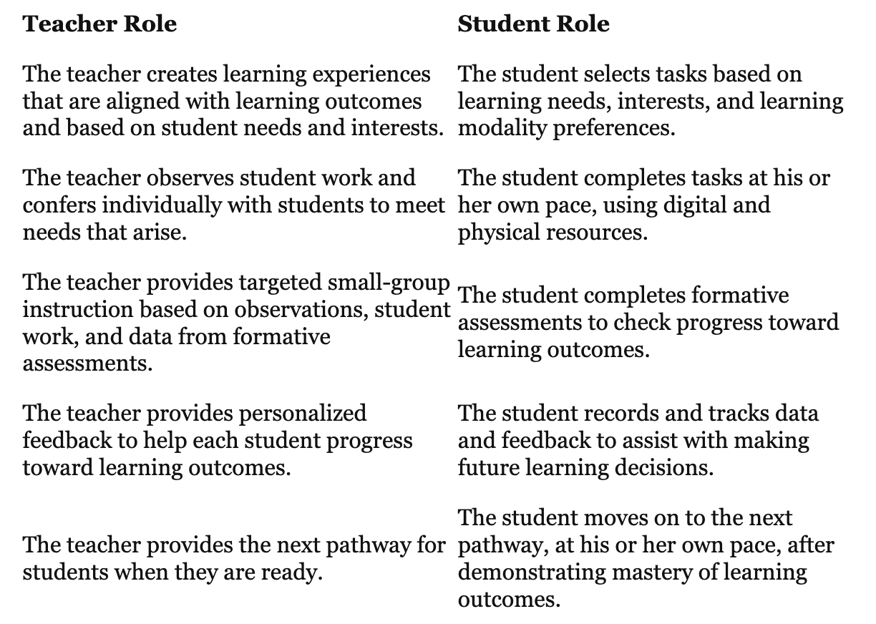
Teacher / Student Roles in a Hybrid Learning Environment
KathleenReardonConsulting.com

Slide 18
Independent Projects - student-driven, design-thinking process, passion-based
Thematic Cross-Curricular Learning - collaborative across subject areas, one core element (e.g., a book, specific learning goal) inspires each subject area
Blended Learning Stations & Rotations - flipped lessons, small groups, mixed media, accessible on-site and off-site
Student Agency, Choice, & Voice - Choice boards, “published” work, authentic audiences
Differentiation & Competency-Based Assessment Models - skill-based assessment, content supports skill development, differentiated across curriculum
Methods & Tools for a Hybrid Learning Environment
KathleenReardonConsulting.com

Slide 19
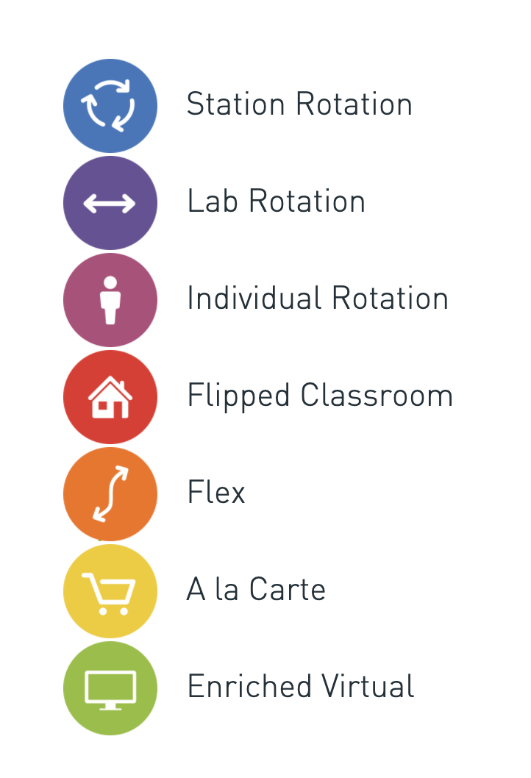
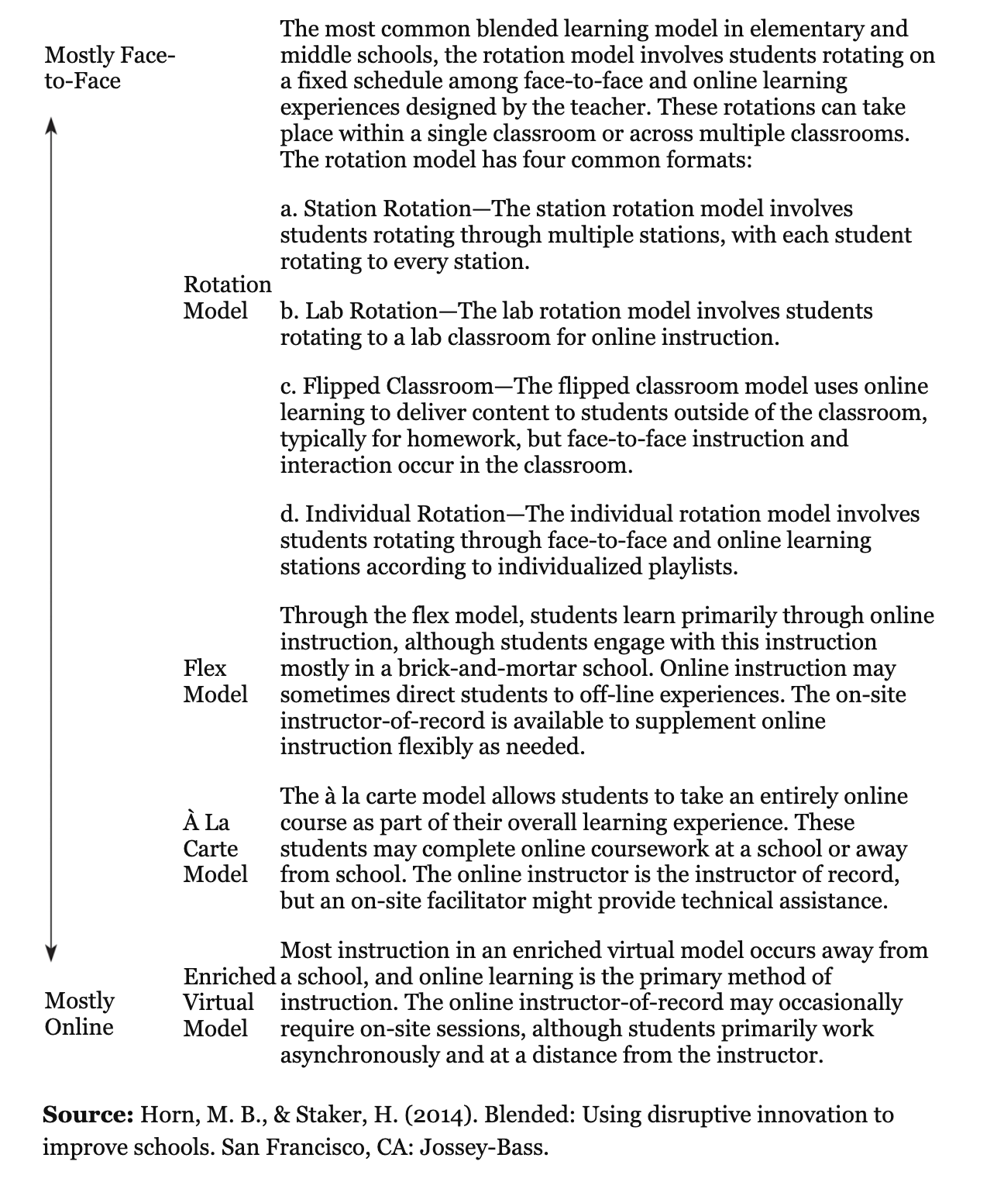
Blended Learning Stations & Rotations
KathleenReardonConsulting.com

Slide 20
Design a Home
Design a one-story home on graph paper or in Sketchup or Minecraft.
Find the area & perimeter of each room and the overall area and perimeter of the entire house.
Mathematician Interview
Think of the mathematicians we have Skyped. Explain why it is important for those professionals to find accurate area and perimeter of objects or spaces.
Anchor Chart (Poster)
Design an anchor chart for area and perimeter on paper or Google Drawings.
Thoroughly explain area and perimeter by including examples, formulas, uses, and illustrations.
Area
and
Perimeter
Choice
Board
Directions:
Form a winning Tic-Tac-Toe!
Choose 3 activities to in a row to complete.
Upload your work into our Seesaw Math folder.
Create a Foldable
Make a foldable for area and perimeter. Visit our Geometry board for 3D shape templates.
Include examples, formulas, uses, illustrations, etc.
Create a Video Quiz
Using one of the videos in our EdPuzzle library, make a 10 question quiz on area and perimeter.
Include at least 2 word problems.
Include an answer key.
Measuring Up
Choose 3 rooms in your home or school to measure.
Find the dimensions of each room (length and width) to the nearest foot, then calculate the area and perimeter of each room.
Real-World
List as many real-world uses for area and perimeter as you can.
Ms. Reardon can list 18! Can you beat that?
Open Mic Night
Create a poem for area and perimeter. Each line of the poem must relate to the topic.
Video a dramatic reading of your poem.
Create Bell-Ringers
Make 5 days of warm-ups for area and perimeter.
Include a variety of question types and answer keys.
KathleenReardonConsulting.com
Notes:
Example: theme is perception/perspective
Book (ELA/SocSt) - how do we perceive others?
Math - how can we measure things without inches, meters, etc?
Writing - how do we perceive? How are we perceived?
Art - creating perspective, horizon line
PE - motor skill development
Supported by SEL, digital citizenship, Growth Ed, etc.

Slide 21
Thematic and Cross-Curricular Design
KathleenReardonConsulting.com
Notes:
Example: theme is perception/perspective
Book (ELA/SocSt) - how do we perceive others?
Math - how can we measure things without inches, meters, etc?
Writing - how do we perceive? How are we perceived?
Art - creating perspective, horizon line
PE - motor skill development
Supported by SEL, digital citizenship, Growth Ed, etc.

Slide 22
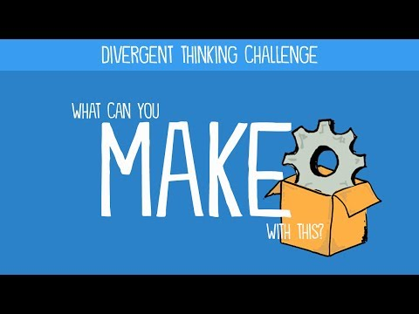
Independent Projects & Thematic Cross-Curricular Learning
Tip: Joanna & Stephanie have lots of great resources for running independent projects!
Need inspiration?
Watch this divergent thinking video:

Slide 23
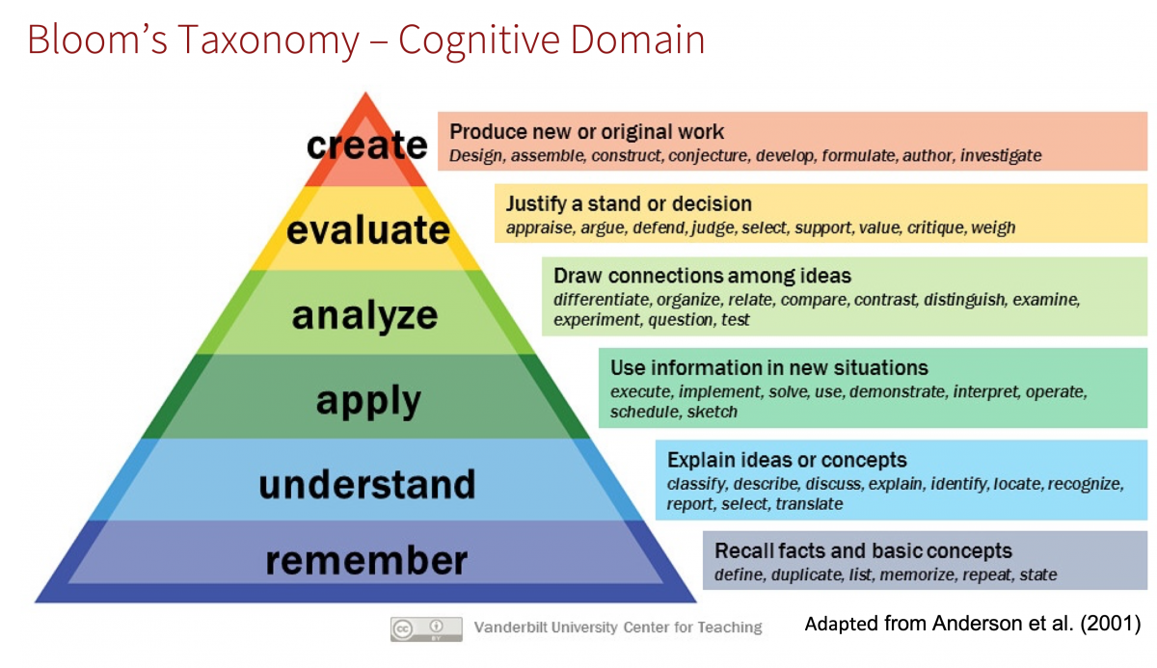
Assessment
Successful hybrid learning relies heavily upon a combination of formative, competency-based, and performance-based assessment practices
Formative Assessment
Qualitative feedback that is provided as part of an ongoing process during student learning. The purpose is to let students know where they are and where they need to go.
Competency-Based Assessment
Creates opportunities for demonstration of important skills in authentic contexts. The purpose is to allow students to demonstrate what they’ve learned, reflect on how they’re doing, and plan for what they’ll learn next.
Performance-Based Assessment
Measures students’ ability to apply skills and knowledge learned from a unit or units of study. Typically, the task challenges students to use higher-order thinking skills to create a product or complete a process. ISM article
https://globalonlineacademy.org/media/publications/CBLHandbook.pdf
KathleenReardonConsulting.com

Slide 24
Assessment
Concerns
Stress related to COVID-19 will negatively impact student academic performance.
Student academic performance during school closures is more likely to reflect racial, economic, and resource differences.
Teachers are being asked to provide high-quality instruction remotely, which many have not done before.
Solutions
Assessment is a meaningful, positive learning experience for students. Real world application is more engaging than worksheets.
Learning experiences are creative experiences that emphasize application of skills and content.
Students receive timely, differentiated learning support based on their individual needs.
Assess and offer feedback continuously, based upon performance throughout the learning process, rather than testing only content at the end of the unit.
Differentiate learning experiences so that students advance at their own pace upon demonstrated mastery, rather than grouped seat time.
Remind students about the Honor Code and general expectations.
Use a Pass/Incomplete grading system.
https://globalonlineacademy.org/media/publications/CBLHandbook.pdf
KathleenReardonConsulting.com

Slide 25

Brainstorm
What if students were assessed according to these six competencies?
How would your curriculum change? How would it stay the same?
What tools would you need to help students be successful in a hybrid learning schedule?
KathleenReardonConsulting.com

Slide 26
What methods could we leverage
in a hybrid learning environment?
July/Aug 2020 In-House PD
KathleenReardonConsulting.com
Notes:
Green slides

Slide 27
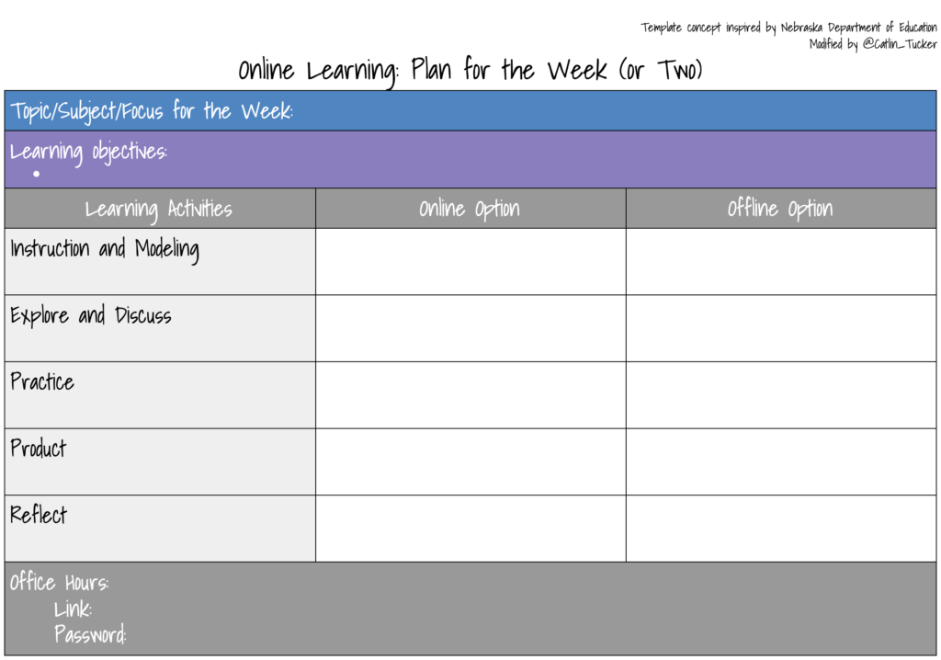
Lesson planning looks a little different for a hybrid learning environment.
Below is a helpful lesson planning template. Click here to get your own Google Doc copy.
KathleenReardonConsulting.com

Slide 28
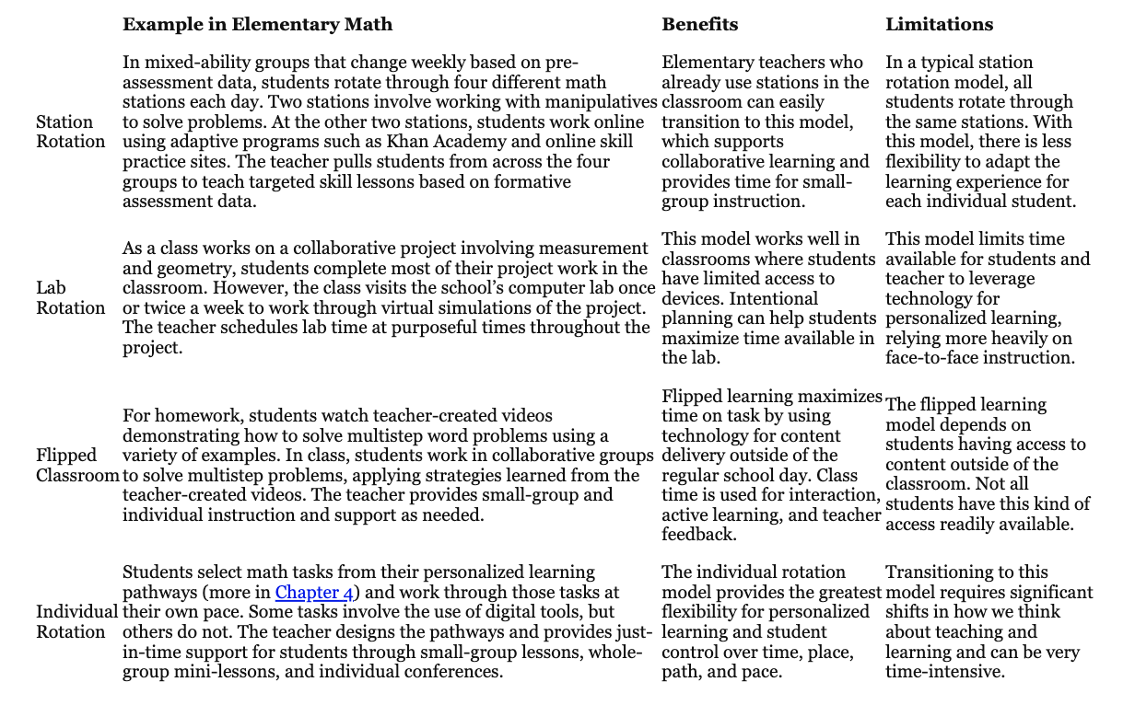
Hybrid Learning in the Math Classroom
KathleenReardonConsulting.com

Slide 29
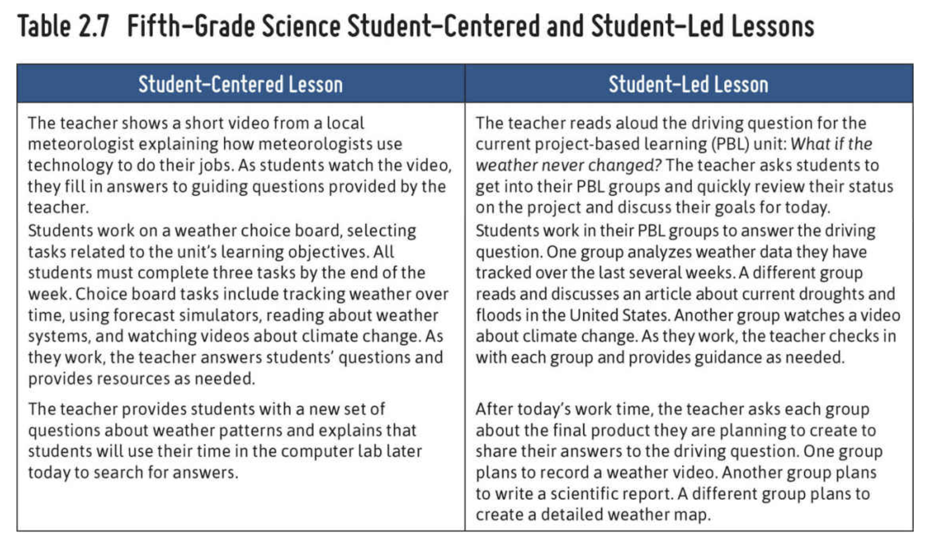
Hybrid Learning in the Science Classroom
KathleenReardonConsulting.com

Slide 30
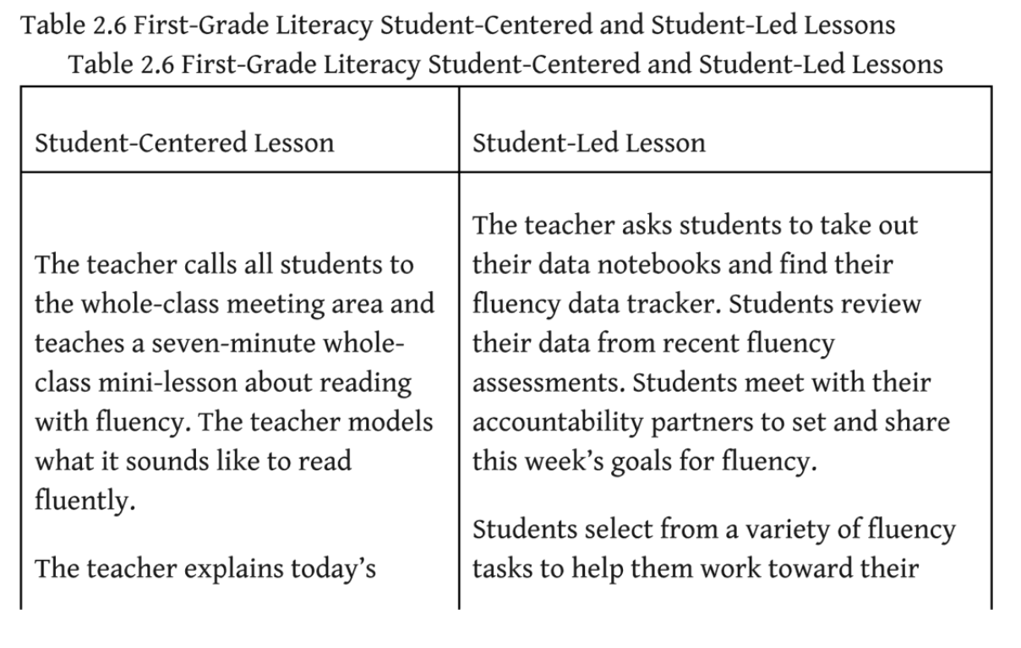
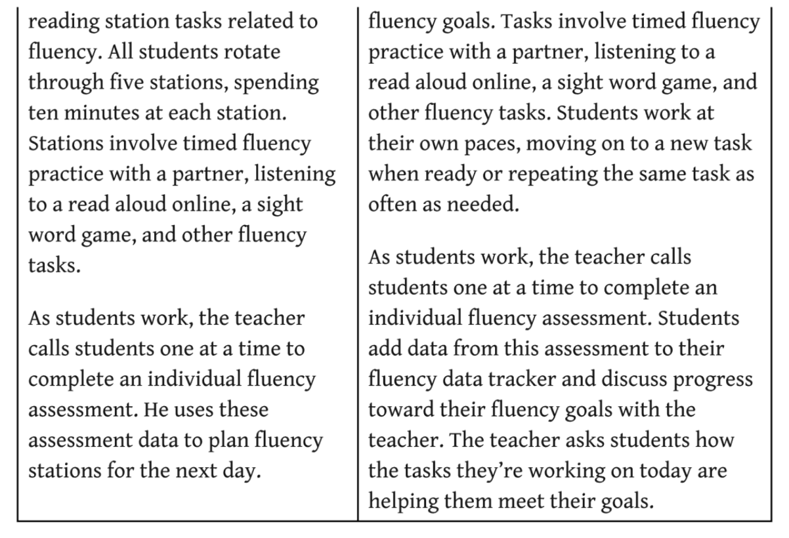
Hybrid Learning
in the
Literacy Classroom
KathleenReardonConsulting.com

Slide 31
Design a Home
Design a one-story home on graph paper or in Sketchup or Minecraft.
Find the area & perimeter of each room and the overall area and perimeter of the entire house.
Mathematician Interview
Think of the mathematicians we have Skyped. Explain why it is important for those professionals to find accurate area and perimeter of objects or spaces.
Anchor Chart (Poster)
Design an anchor chart for area and perimeter on paper or Google Drawings.
Thoroughly explain area and perimeter by including examples, formulas, uses, and illustrations.
Area
and
Perimeter
Choice
Board
Directions:
Form a winning Tic-Tac-Toe!
Choose 3 activities to in a row to complete.
Upload your work into our Seesaw Math folder.
Create a Foldable
Make a foldable for area and perimeter. Visit our Geometry board for 3D shape templates.
Include examples, formulas, uses, illustrations, etc.
Create a Video Quiz
Using one of the videos in our EdPuzzle library, make a 10 question quiz on area and perimeter.
Include at least 2 word problems.
Include an answer key.
Measuring Up
Choose 3 rooms in your home or school to measure.
Find the dimensions of each room (length and width) to the nearest foot, then calculate the area and perimeter of each room.
Real-World
List as many real-world uses for area and perimeter as you can.
Ms. Reardon can list 18! Can you beat that?
Open Mic Night
Create a poem for area and perimeter. Each line of the poem must relate to the topic.
Video a dramatic reading of your poem.
Create Bell-Ringers
Make 5 days of warm-ups for area and perimeter.
Include a variety of question types and answer keys.
KathleenReardonConsulting.com
Notes:
Example: theme is perception/perspective
Book (ELA/SocSt) - how do we perceive others?
Math - how can we measure things without inches, meters, etc?
Writing - how do we perceive? How are we perceived?
Art - creating perspective, horizon line
PE - motor skill development
Supported by SEL, digital citizenship, Growth Ed, etc.

Slide 32
Thematic and Cross-Curricular Design
KathleenReardonConsulting.com
Notes:
Example: theme is perception/perspective
Book (ELA/SocSt) - how do we perceive others?
Math - how can we measure things without inches, meters, etc?
Writing - how do we perceive? How are we perceived?
Art - creating perspective, horizon line
PE - motor skill development
Supported by SEL, digital citizenship, Growth Ed, etc.

Slide 33
Independent Projects & Thematic Cross-Curricular Learning
Tip: Joanna & Stephanie have lots of great resources for running independent projects!
Need inspiration?
Watch this divergent thinking video:

Slide 34
What tools could we leverage in a hybrid learning environment?
August 2020 In-House PD
KathleenReardonConsulting.com
Notes:
Purple slides

Slide 35
KathleenReardonConsulting.com

Slide 36
















What gaps need new solutions?
What has worked well?
How can we support families who don’t own printers?
Convert your worksheets into interactive Slides
Create personalized interactive lessons with the VR library
How can we embrace project-based learning?
Brainstorm and map student projects
Critical thinking/ Online Debate
How can we assess skills?
Students run diagnostics on their written work before submitting
Embed quizzes
into videos
KathleenReardonConsulting.com

Slide 37
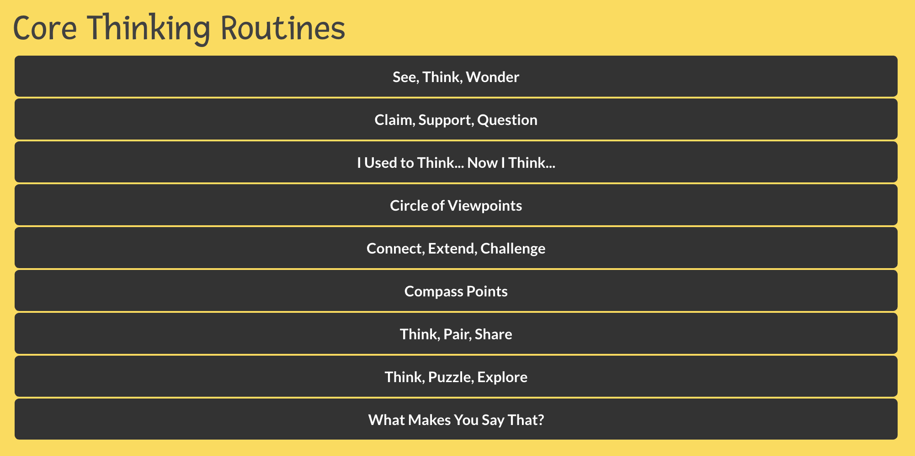
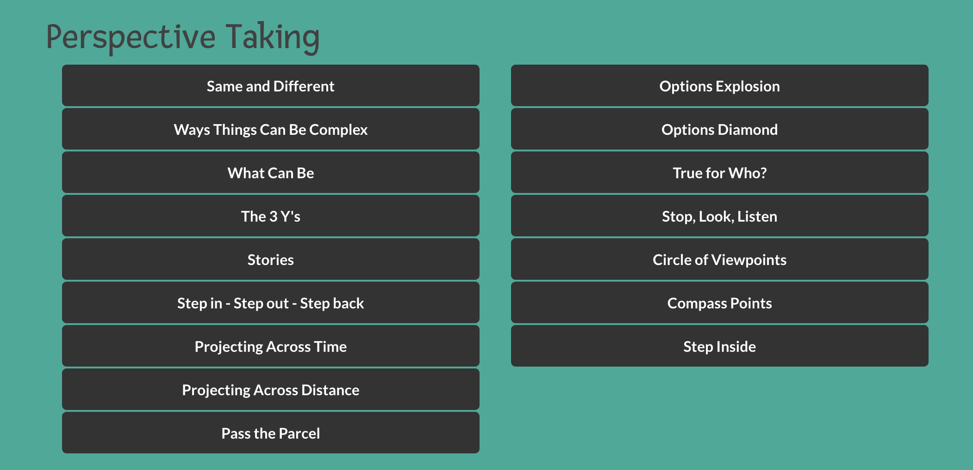
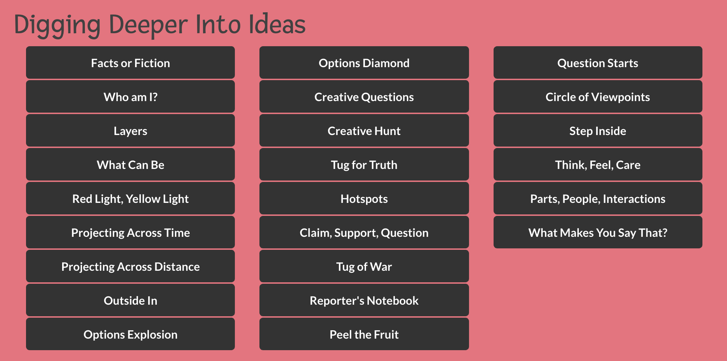
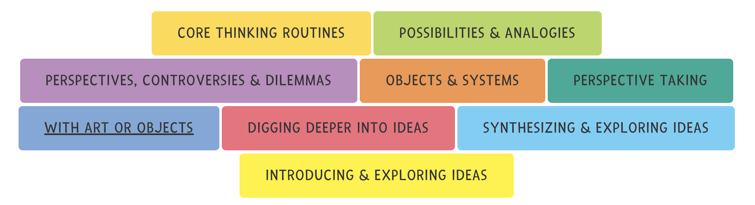
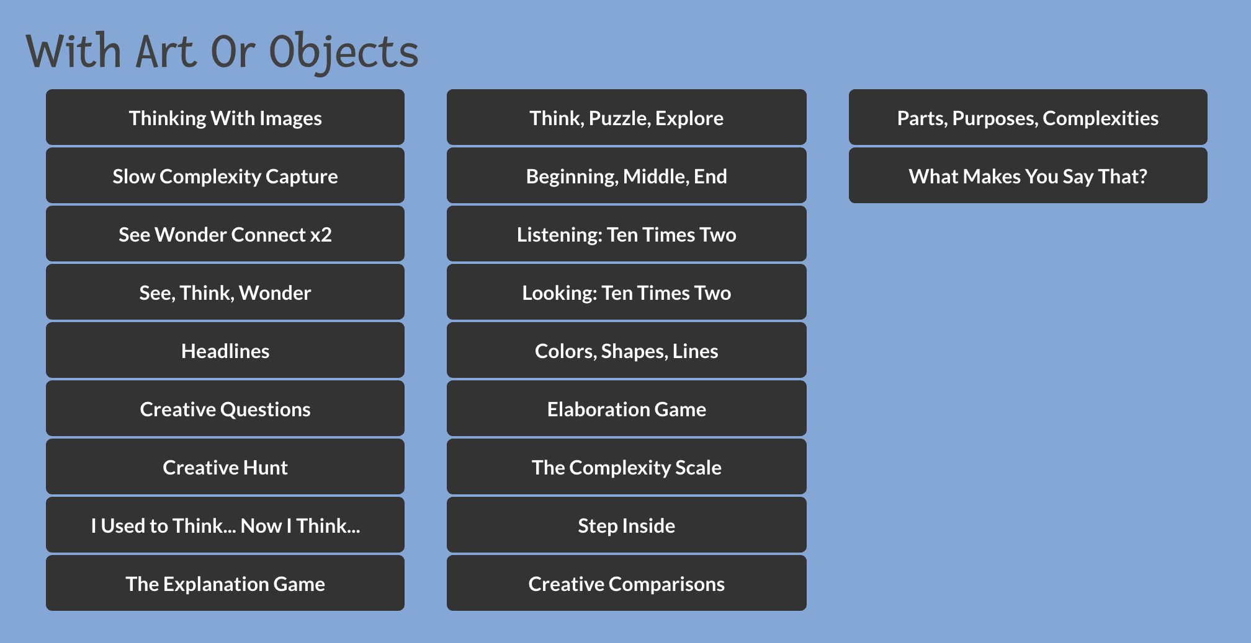
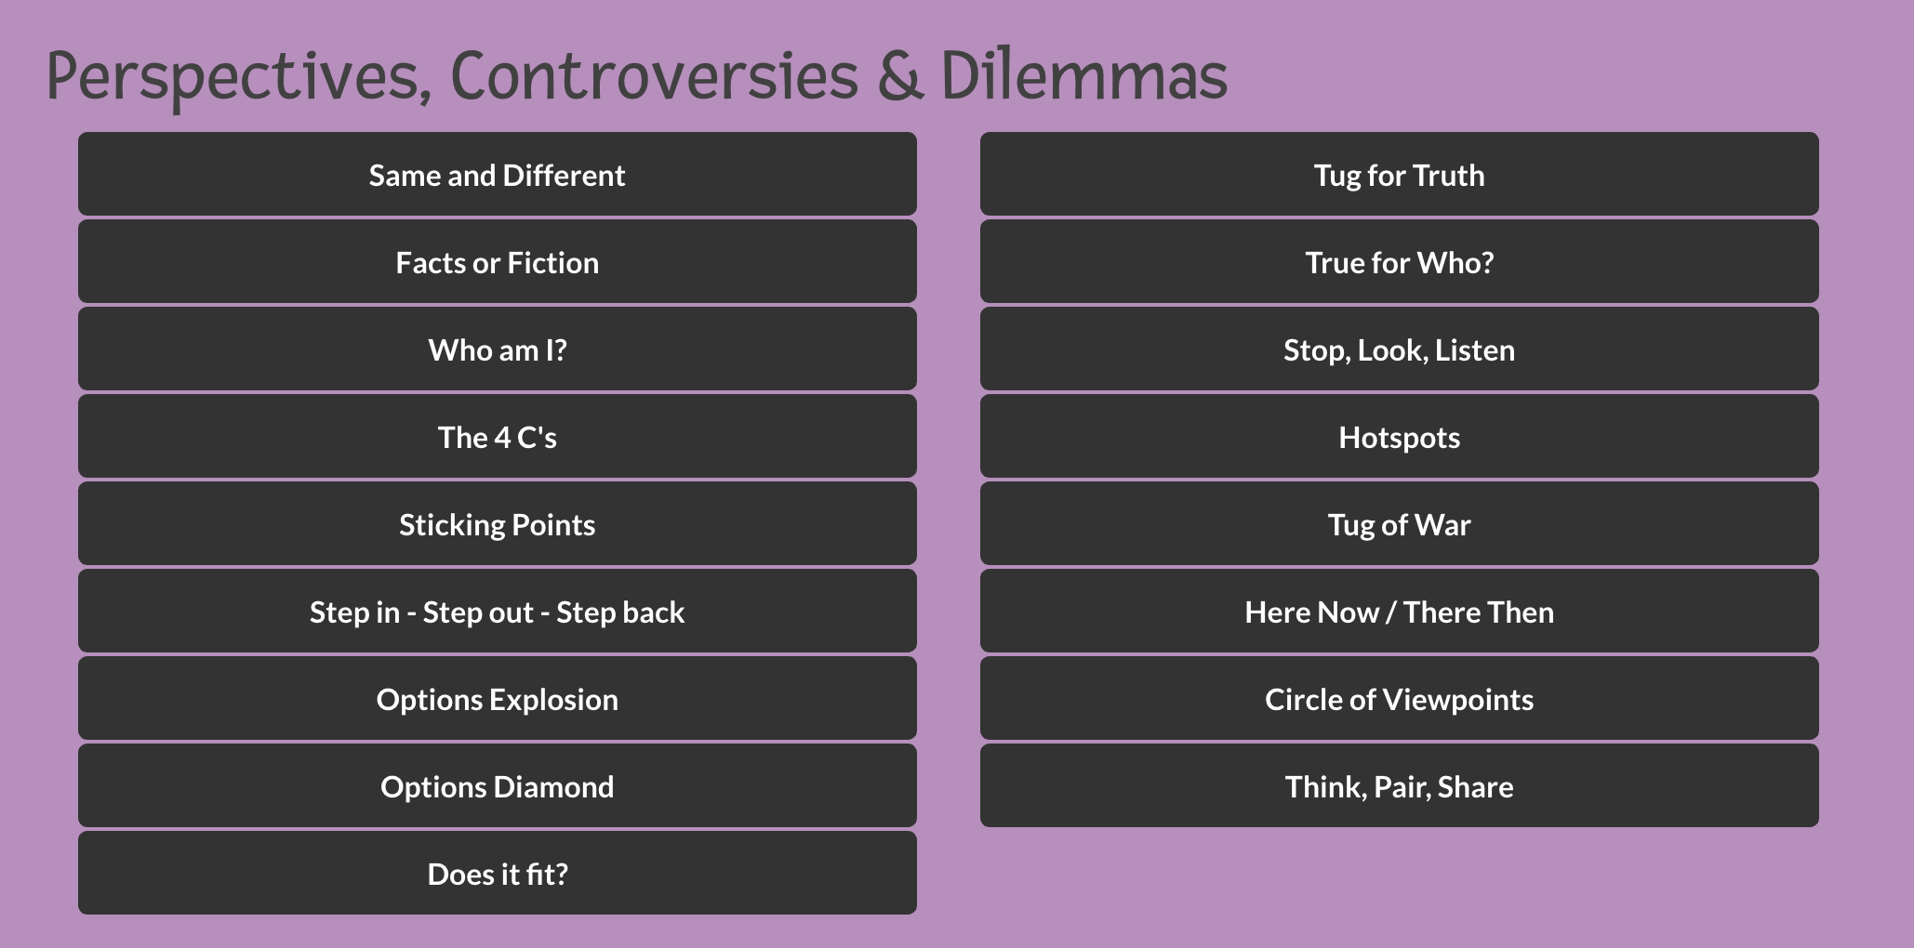
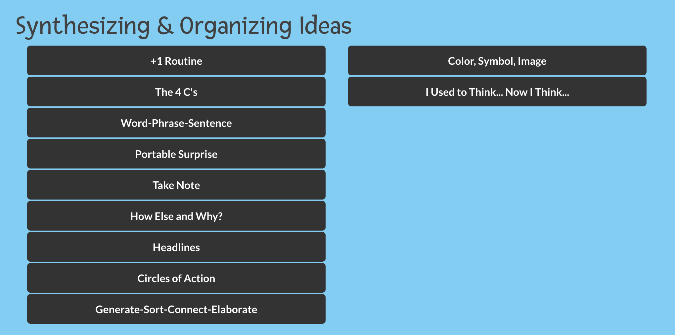
Project Zero’s Thinking Routines and Strategies for Collaborative Learning in the Blended Classroom
KathleenReardonConsulting.com

Slide 38
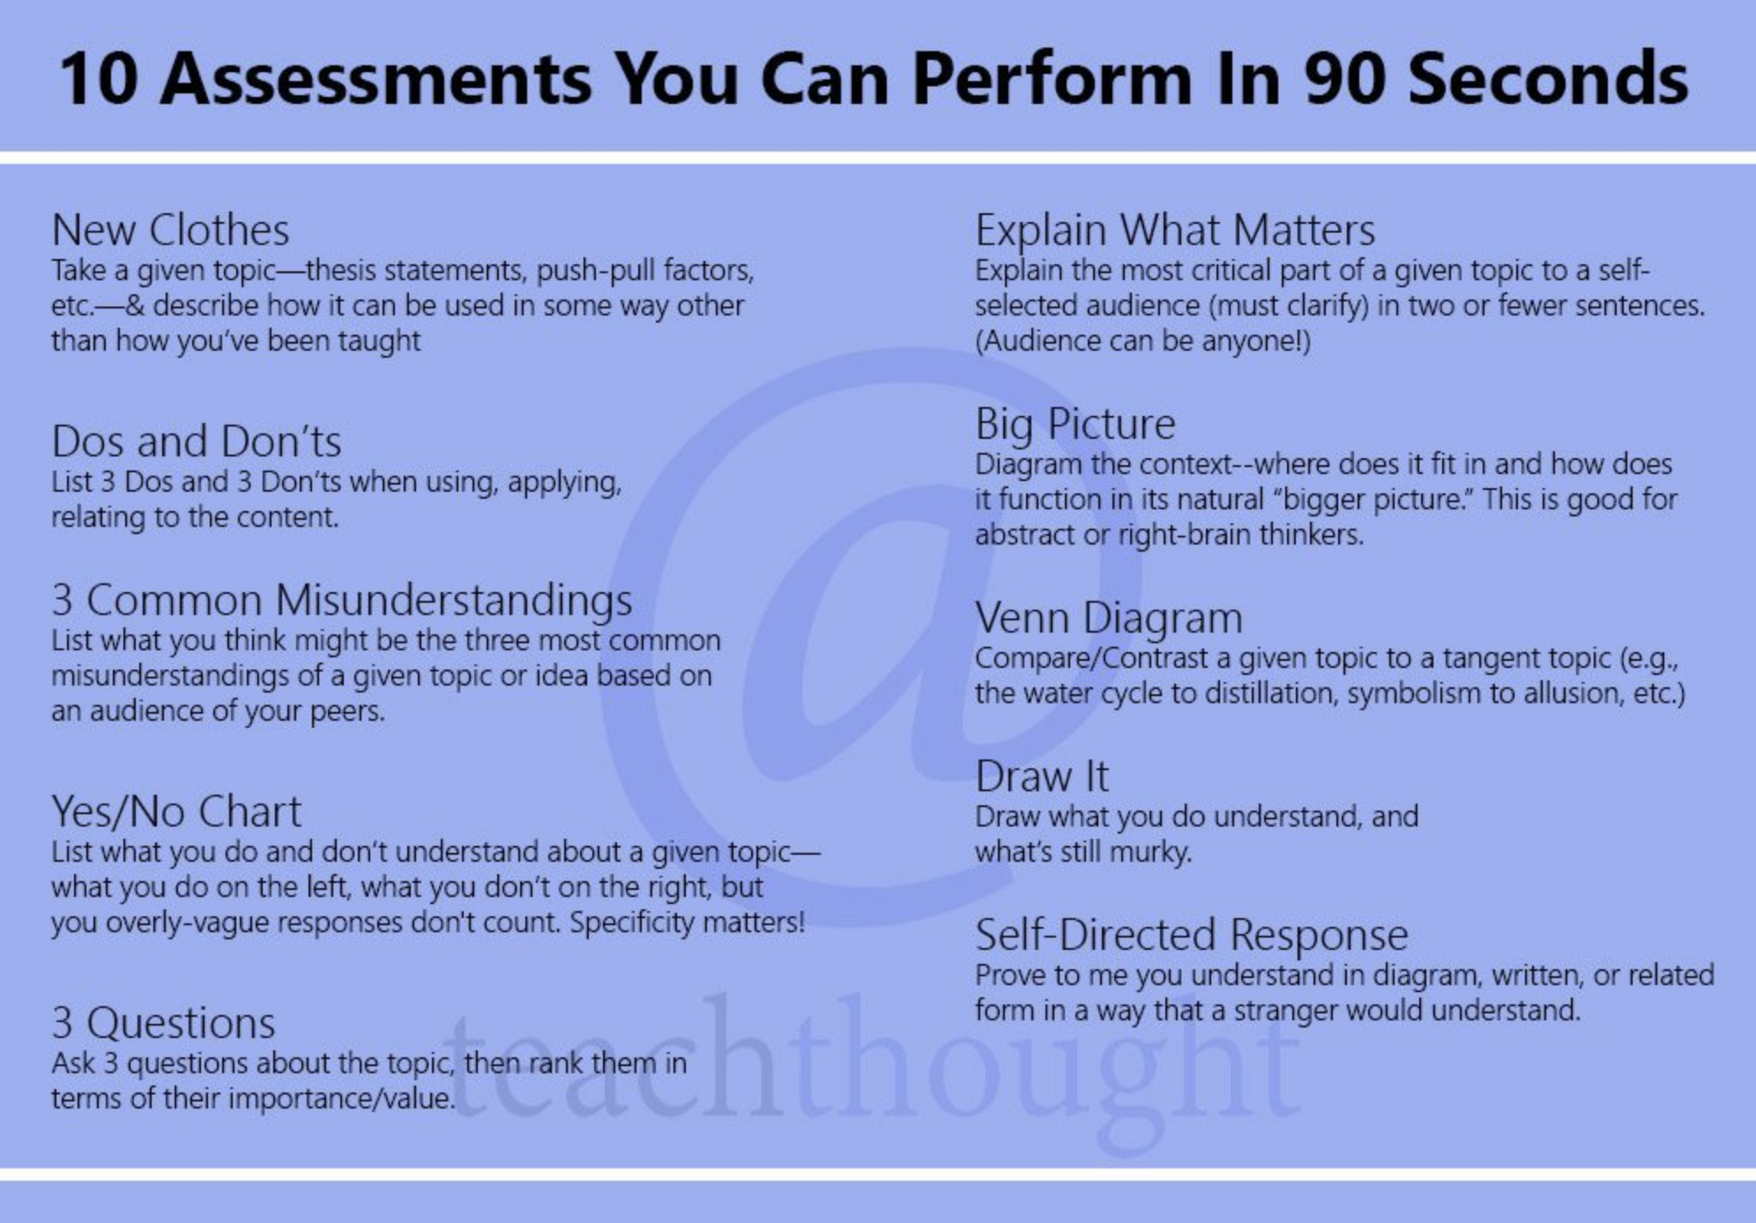
Want more? Check out this list of 40 Reflection Questions
KathleenReardonConsulting.com

Slide 39
What materials & tools will students need to access at home?
Workbooks & paper materials
Are there digital versions available? How are they ordered?
Hardware & Devices
Do families need to borrow school devices? How will they be distributed?
Live-streaming hardware in classrooms
Increased bandwidth
Might need to accelerate digital citizenship curriculum & device distribution schedule
Usernames & Passwords
Set aside Day 1 of online learning for families to acclimate to devices, organize materials, & log in.
Expectations
Clearly articulate expectations and assessment methods for families.
Communication Channels
Explain to families how they will be able to communicate with teachers, support staff, and administration.
KathleenReardonConsulting.com

Slide 40
How Do You Decide
Which Strategies, Tools, and Resources to Use?
Ask Kate
Visit our Tech Dept Website
Brainstorm with your colleagues
Ask your students
Trust what you know - you already use lots of tools and create wonderful blended learning experiences for our students!
KathleenReardonConsulting.com

Slide 41
What mindsets will we need to leverage to be successful
in a hybrid learning environment?
August 2020 In-House PD
KathleenReardonConsulting.com
Notes:
Green slides

Slide 42
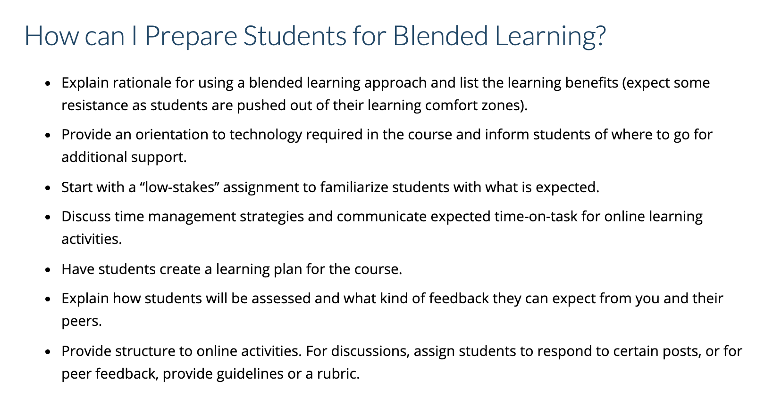
Families
Hybrid
KathleenReardonConsulting.com

Slide 43
INSERT SLIDES FROM JUNE SEL TRAINING HERE
KathleenReardonConsulting.com

Slide 44
TEMPLATES
KathleenReardonConsulting.com

Slide 45
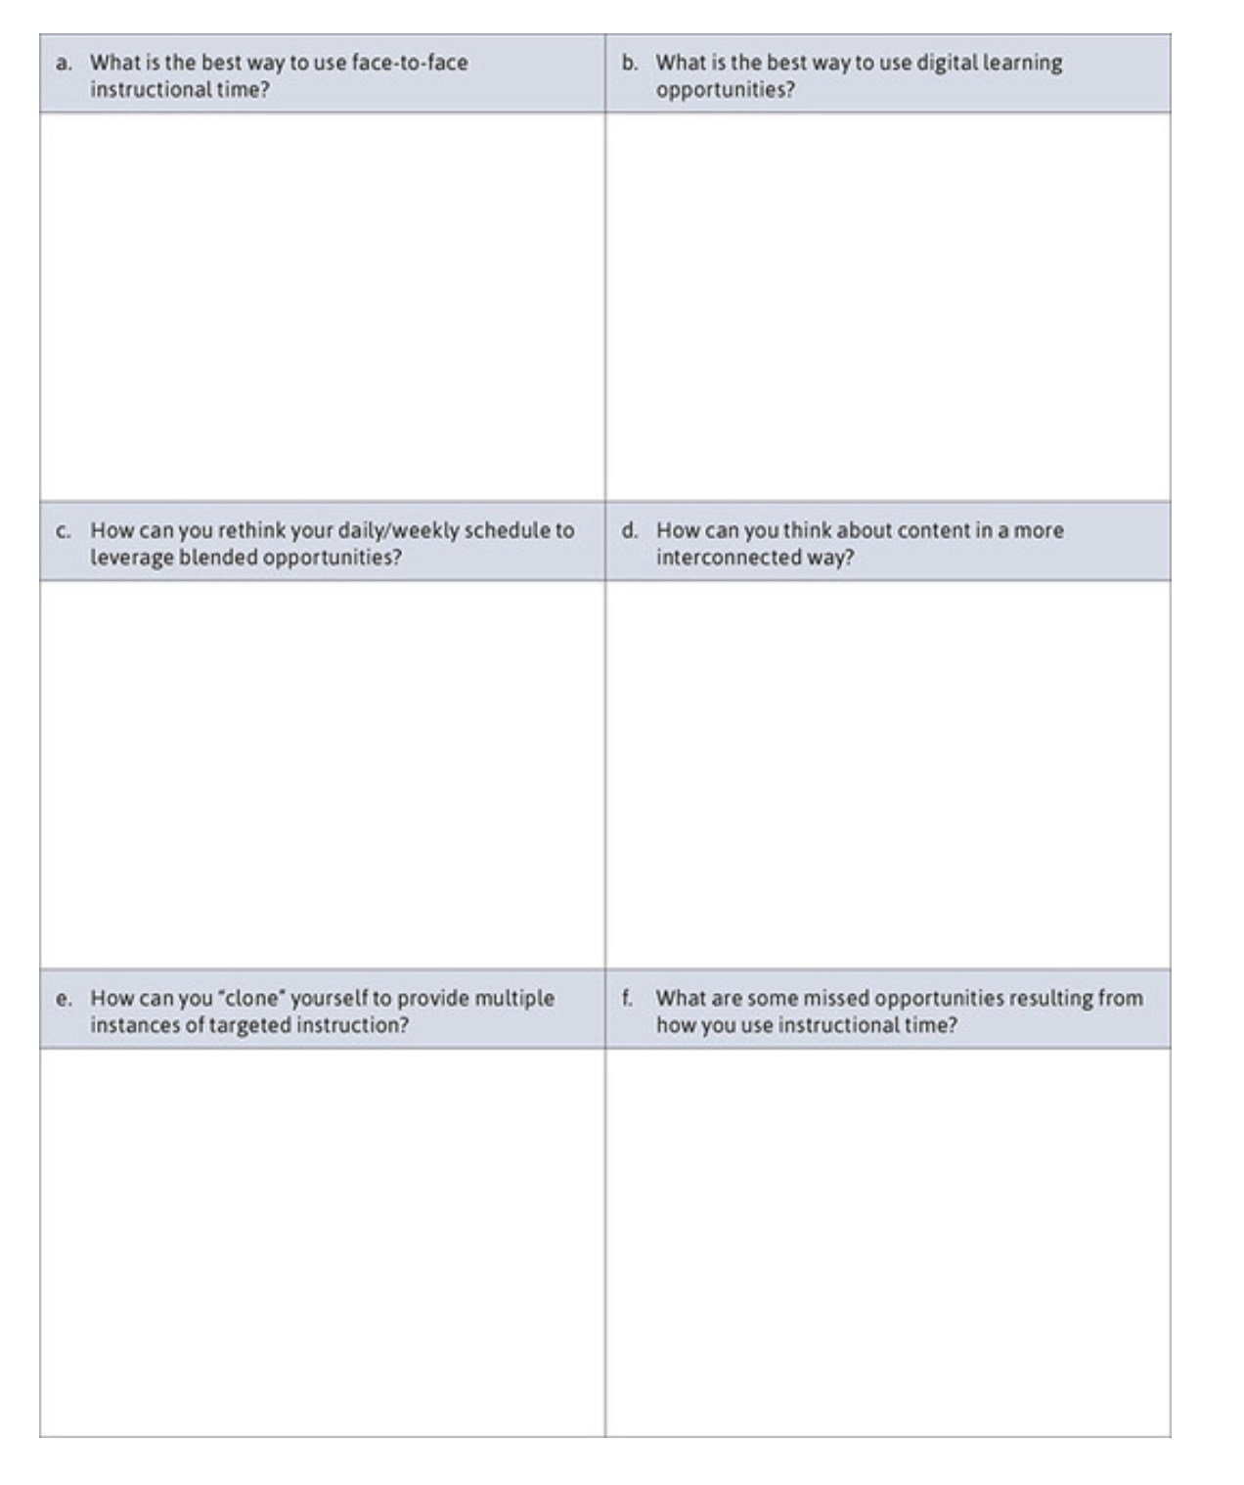
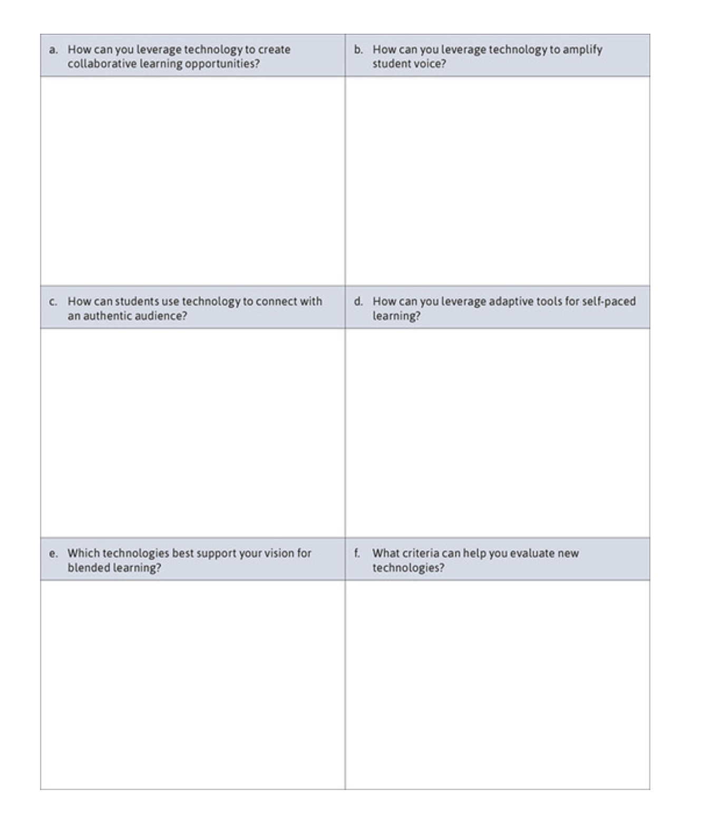
Discussion Guide for Teams Planning Blended Learning Curriculum
KathleenReardonConsulting.com

Slide 46
Lesson planning looks a little different for a hybrid learning environment.
Below is a helpful lesson planning template. Click here to get your own Google Doc copy.
KathleenReardonConsulting.com

Slide 47
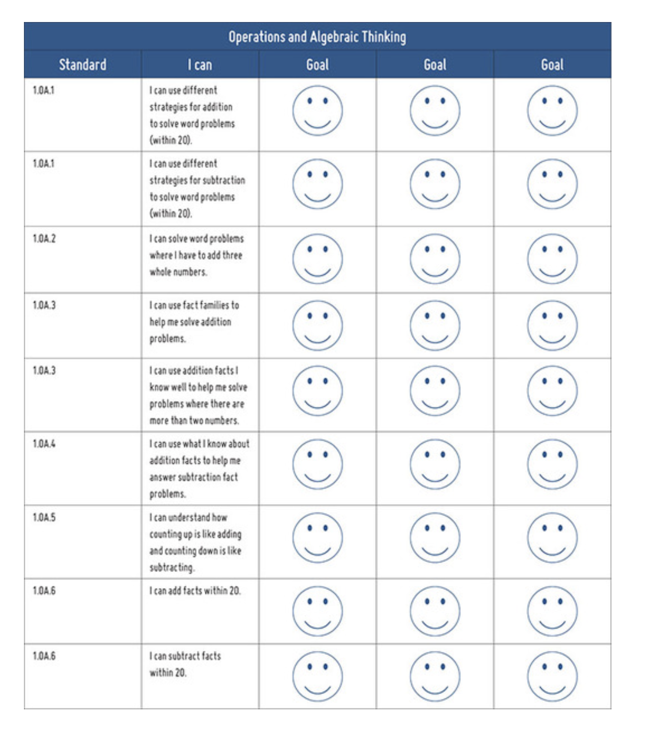
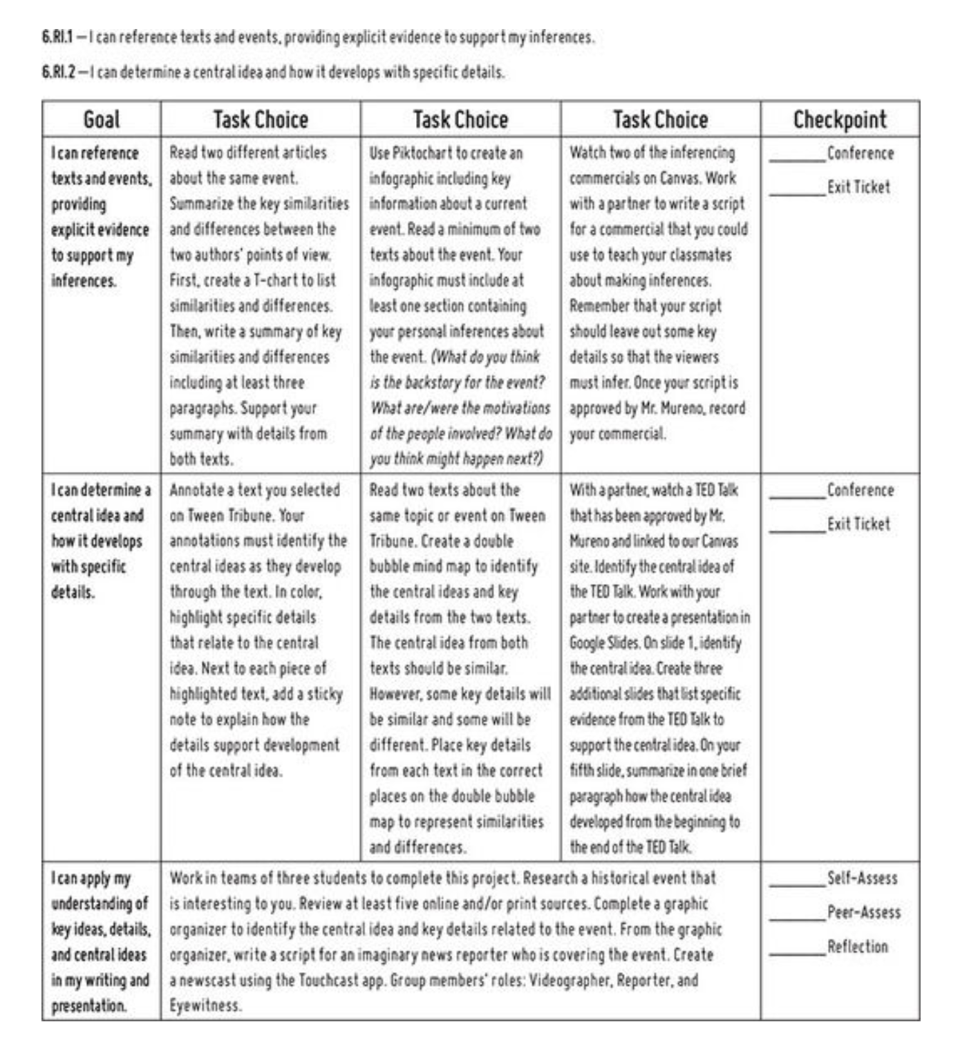
Student Self-assessment Using “I can” Statements
KathleenReardonConsulting.com

Slide 48
Sources
The Blended Learning Blueprint for Elementary Teachers by Jayme Linton
Blended Learning, NYU Arts & Sciences, FAS Office of Educational Technology
Blended or Hybrid Learning, Tech 4 Teaching & Learning
Getting Started With Designing a Blended Learning Course, Cornell University Center for Teaching Innovation
Harvard’s Project Zero Resources and Thinking Routines
Catlin Tucker’s site resources and recommendations
BlendedLearning.org resources and recommendations
Global Education Collective network and online forum
Recommendations for Grading During COVID-19 School Closures by Joe Feldman
12 Types of Blended Learning, TeachThought
Colored Pencil Slides are from Slides Carnival - Ely
KathleenReardonConsulting.com

Slide 49
Notes and Extra Slides
KathleenReardonConsulting.com

Slide 50
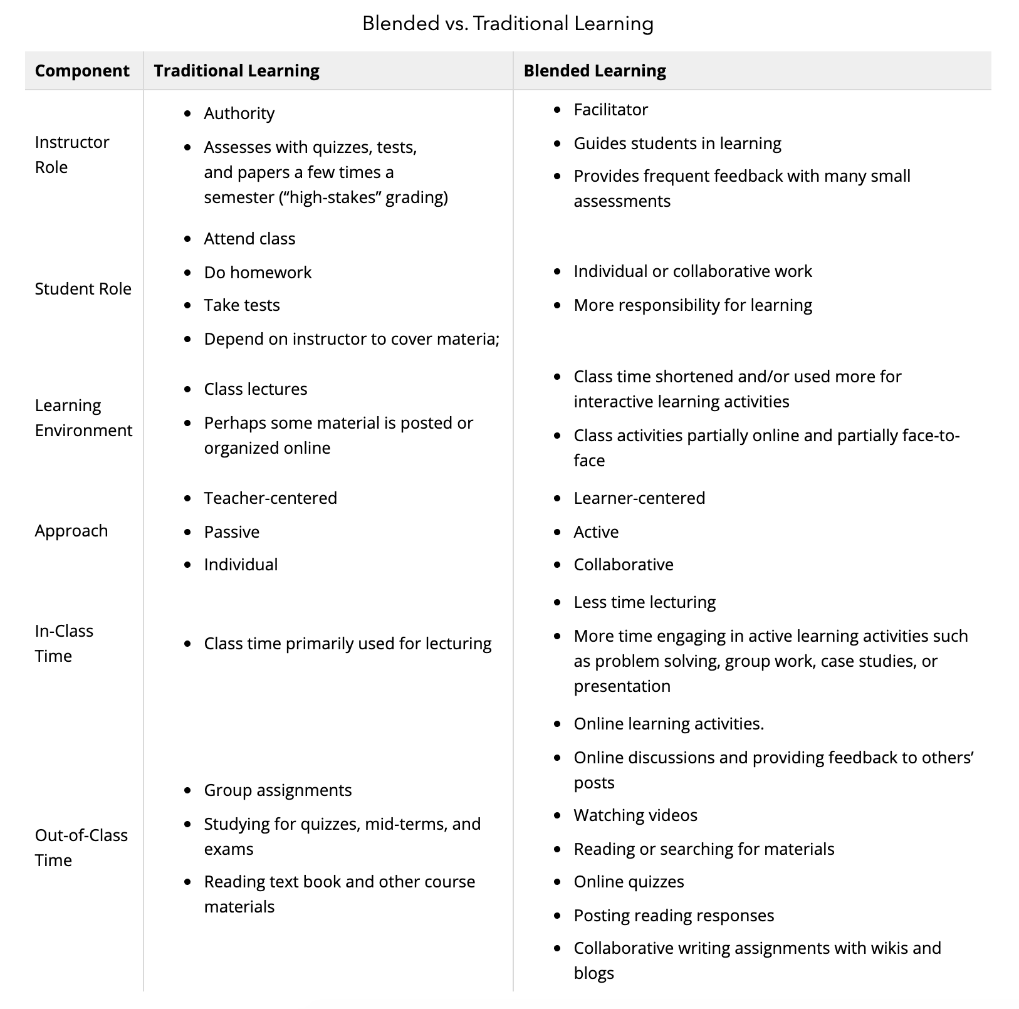
How is blended learning different from the traditional classroom?
How can we use blended learning models in a hybrid learning environment?
KathleenReardonConsulting.com

Slide 51
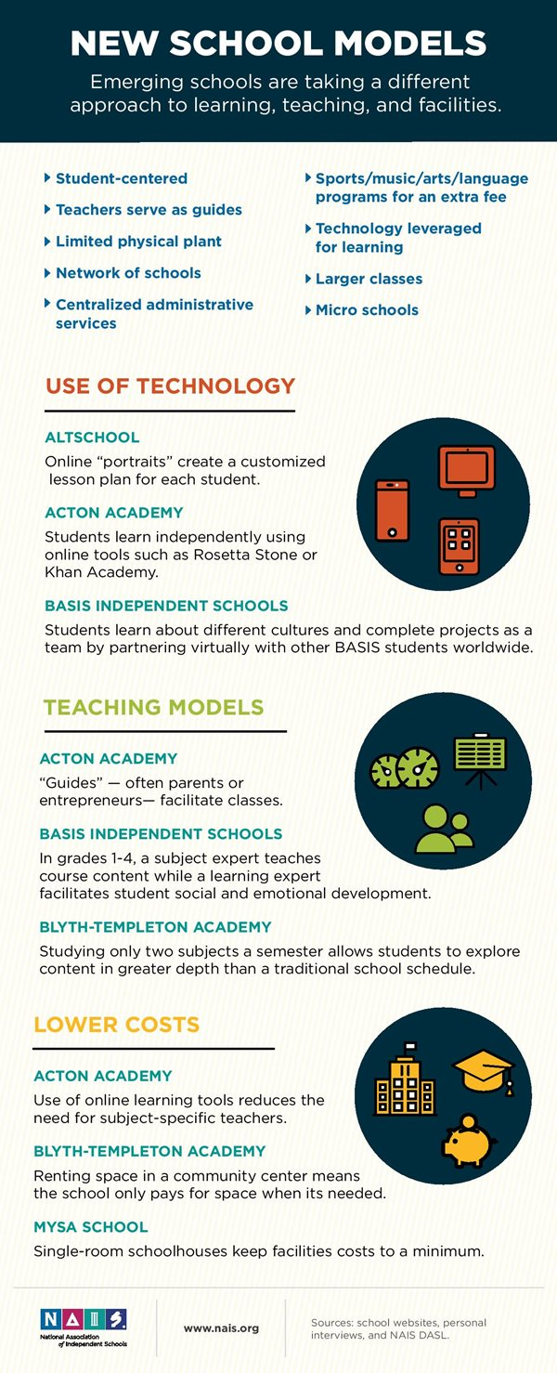
KathleenReardonConsulting.com

Slide 52
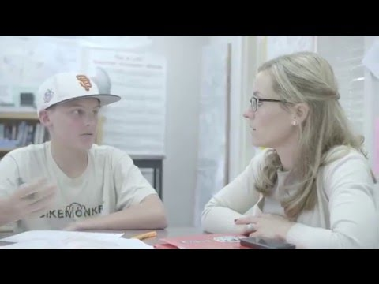
Catlin Tucker is an teacher, author, and speaker on blended learning.
You can find her resources here: CatlinTucker.com
KathleenReardonConsulting.com

Slide 53
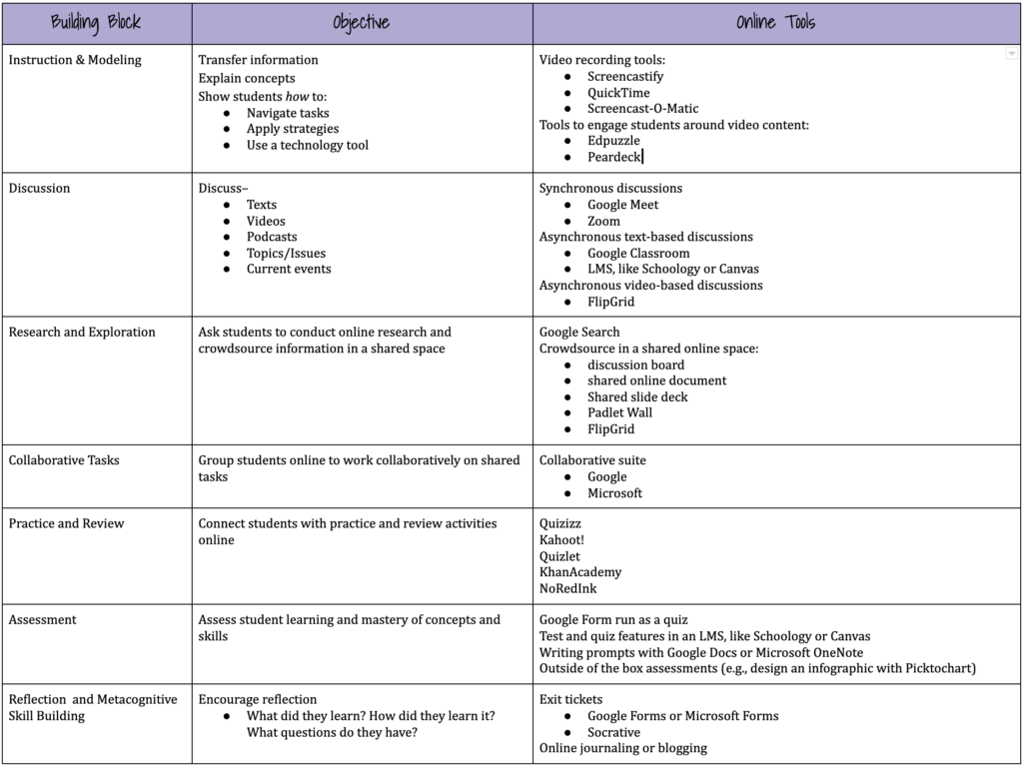
This is hard to read, so please click here for a clearer view:
Building Blocks of an Online Lesson
KathleenReardonConsulting.com

Slide 54



Emergency Closure vs. Hybrid Learning Environment
Successes
Quick turnaround in making programming available online
Leverage of new tech tools to facilitate connection and content delivery
Schools that employed “all hands on deck” approach saw greater success than pared-down approach
Challenges
High rate of substitution, low rate of redefinition due to time constraints
Tech solutions are “hacked” to serve undesigned purposes, especially heavy use of PDFs for unintended purposes
Numerous & often poorly timed updates of tech
Opportunities
Teachers & administration have time to plan & build out resources & infrastructure
New tech tools & features come the market specifically designed to meet hybrid learning needs
Cross-curriculuar learning experiences are redesigned to be nimble and flexible in delivery
Challenges
Reduction in seat time balanced by team-teaching or cross-curricular approach
Reliability of technology and infrastructure is of key importance
Schools that strategically include families in planning process see greater success
KathleenReardonConsulting.com
The Brain Dictionary interactive map and The Brain Dictionary video

Slide 55
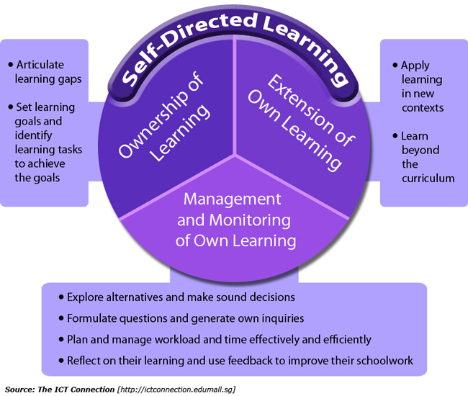
Independent Projects
Thematic Cross-Curricular Learning
Blended Learning Stations & Rotations
Student Agency, Choice, & Voice
Self-Guided Learning
Differentiation & Competency-Based Assessment Models
How do we approach our curriculum differently
in a hybrid learning environment?
KathleenReardonConsulting.com

